Slide 1
Hierarchical Abundance Modeling to Inform Oak Savanna Habitat Restoration

Slide 2
Hierarchical Abundance Modeling to Inform Oak Savanna Habitat Restoration
For Minnesota Species in Greatest Conservation Need

Slide 3
University of Minnesota
Fisheries, Wildlife, Conservation Biology
Minnesota Department of Natural Resources
Nongame Wildlife

Slide 4
USFWS State Wildlife Grants Program
MN Department of Natural Resources
MN Herpetological Society
University of Minnesota

Slide 5
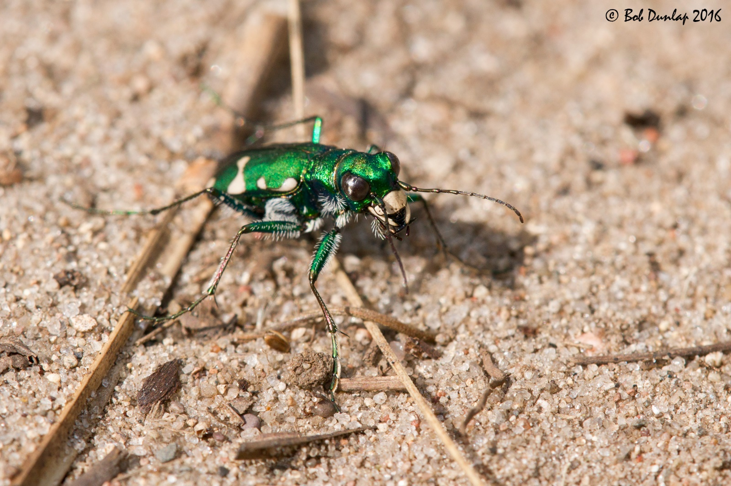
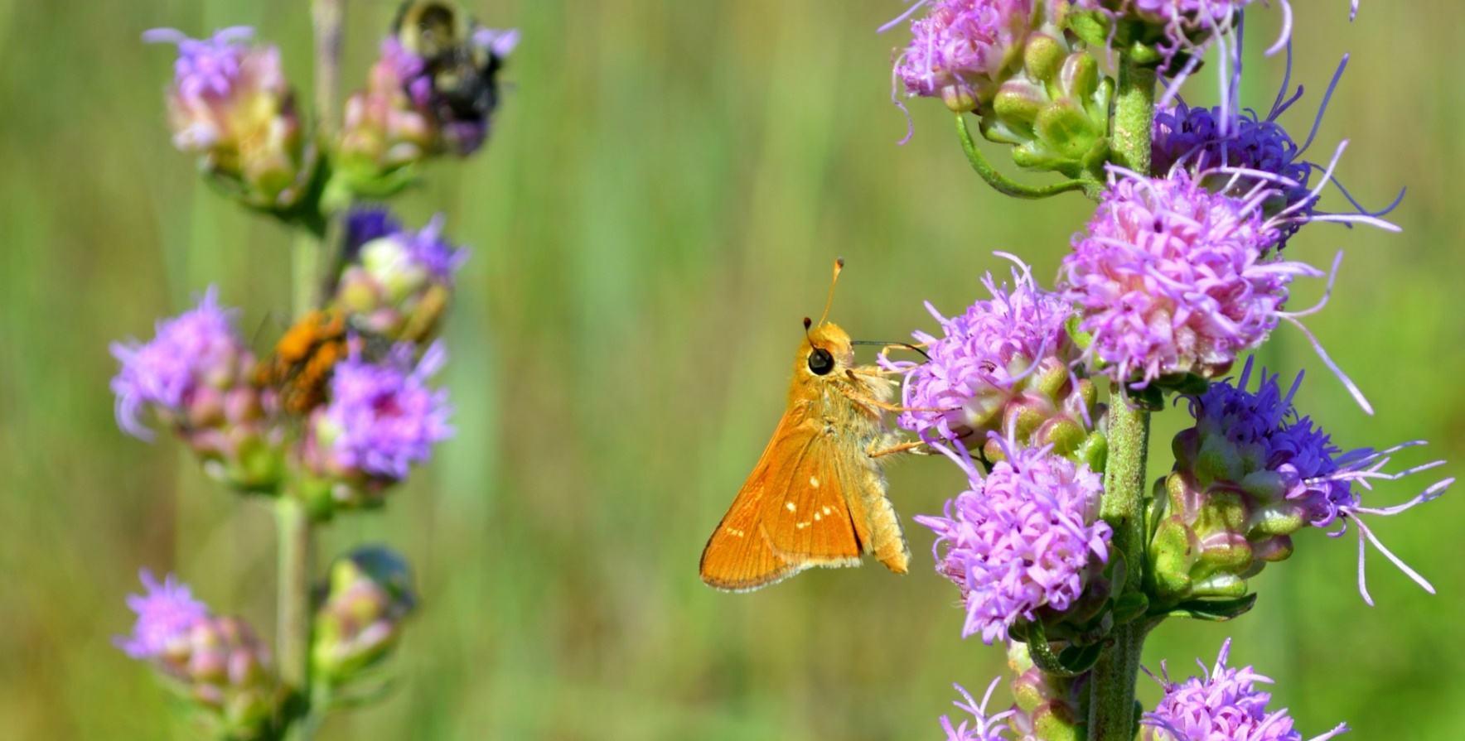
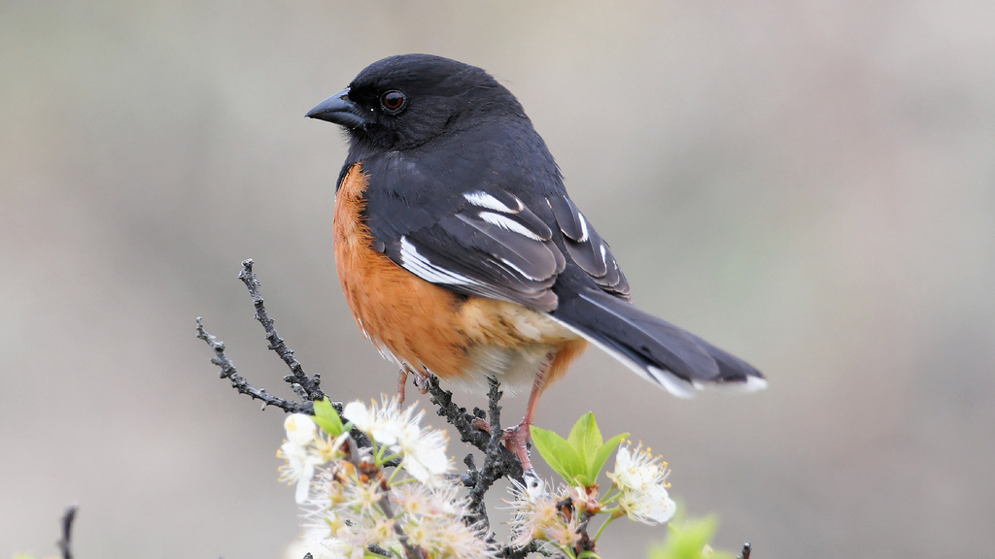
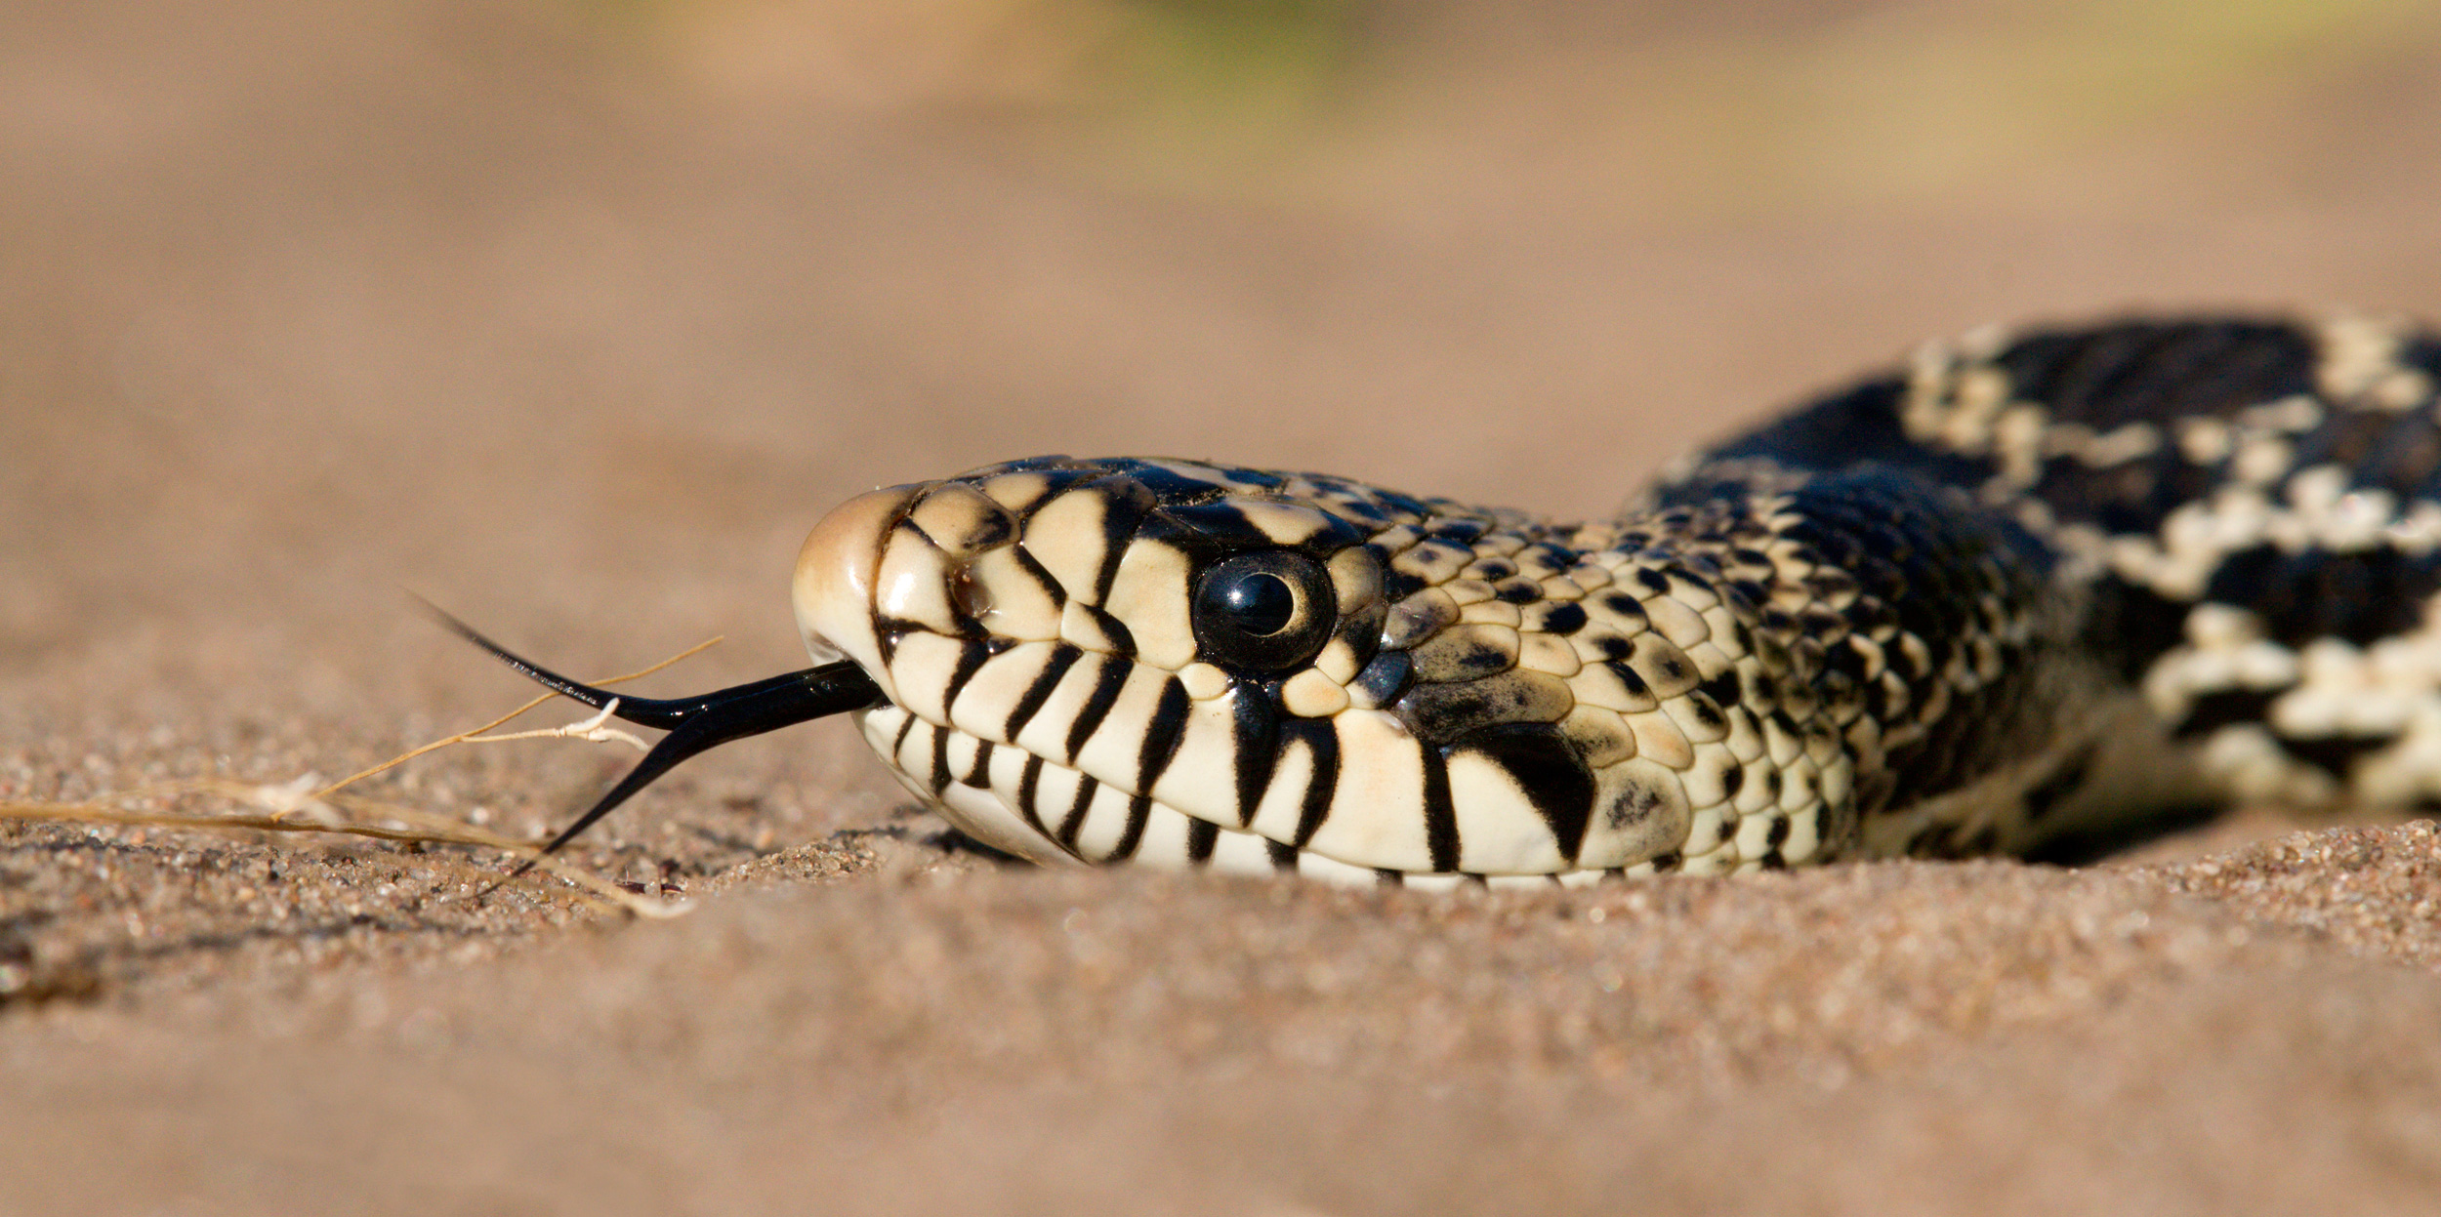
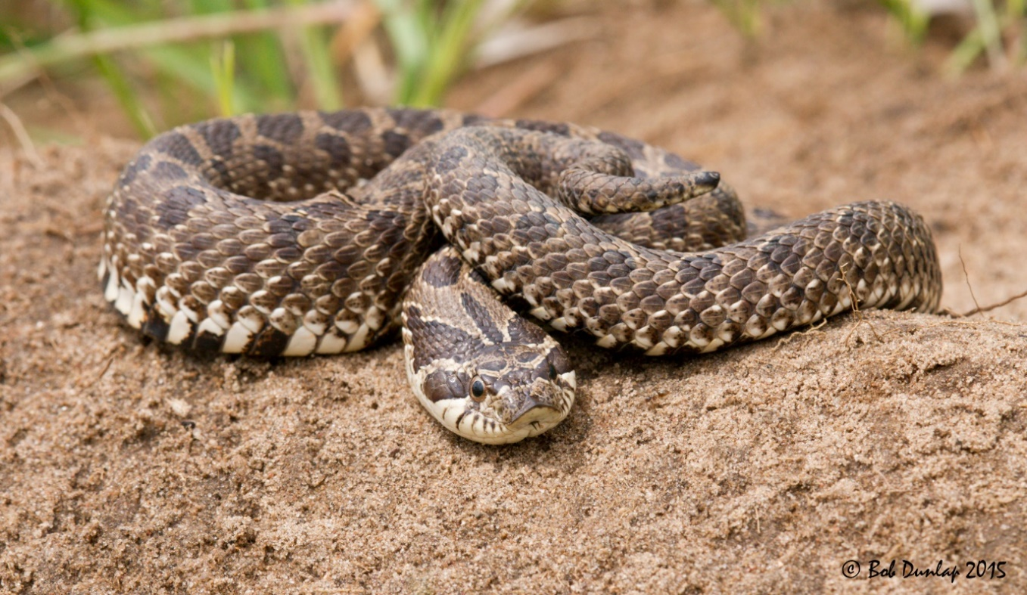
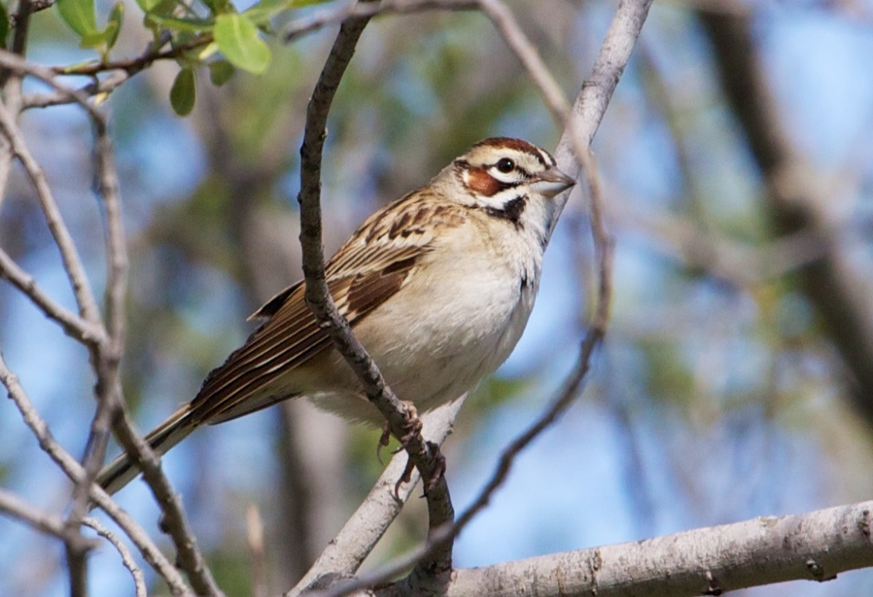
Notes:
These are species that evolved along with the native habitats that we are trying to restore. So, we can use their collective distribution, abundance, and response to management as a way to inform restoration.

Slide 6
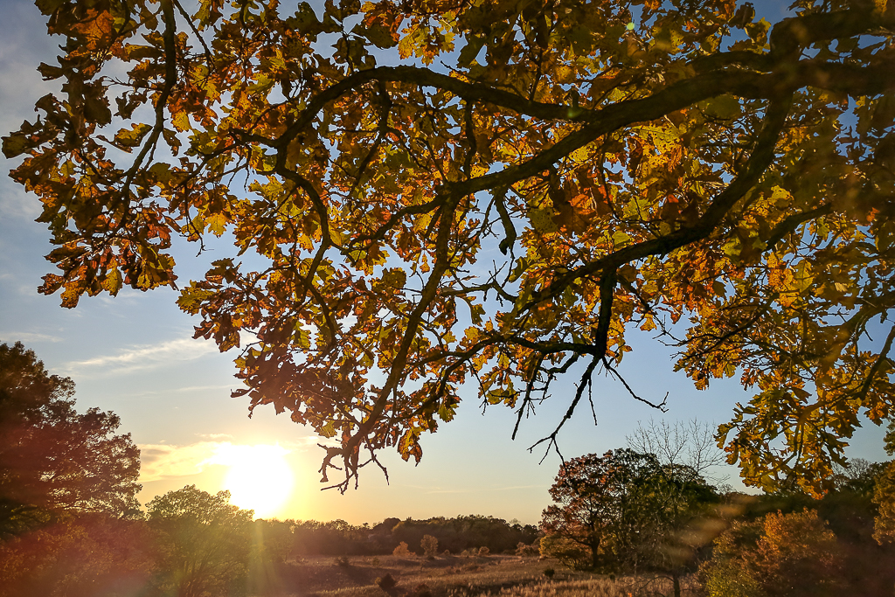
Photo Credit: Brett Whaley

Slide 7
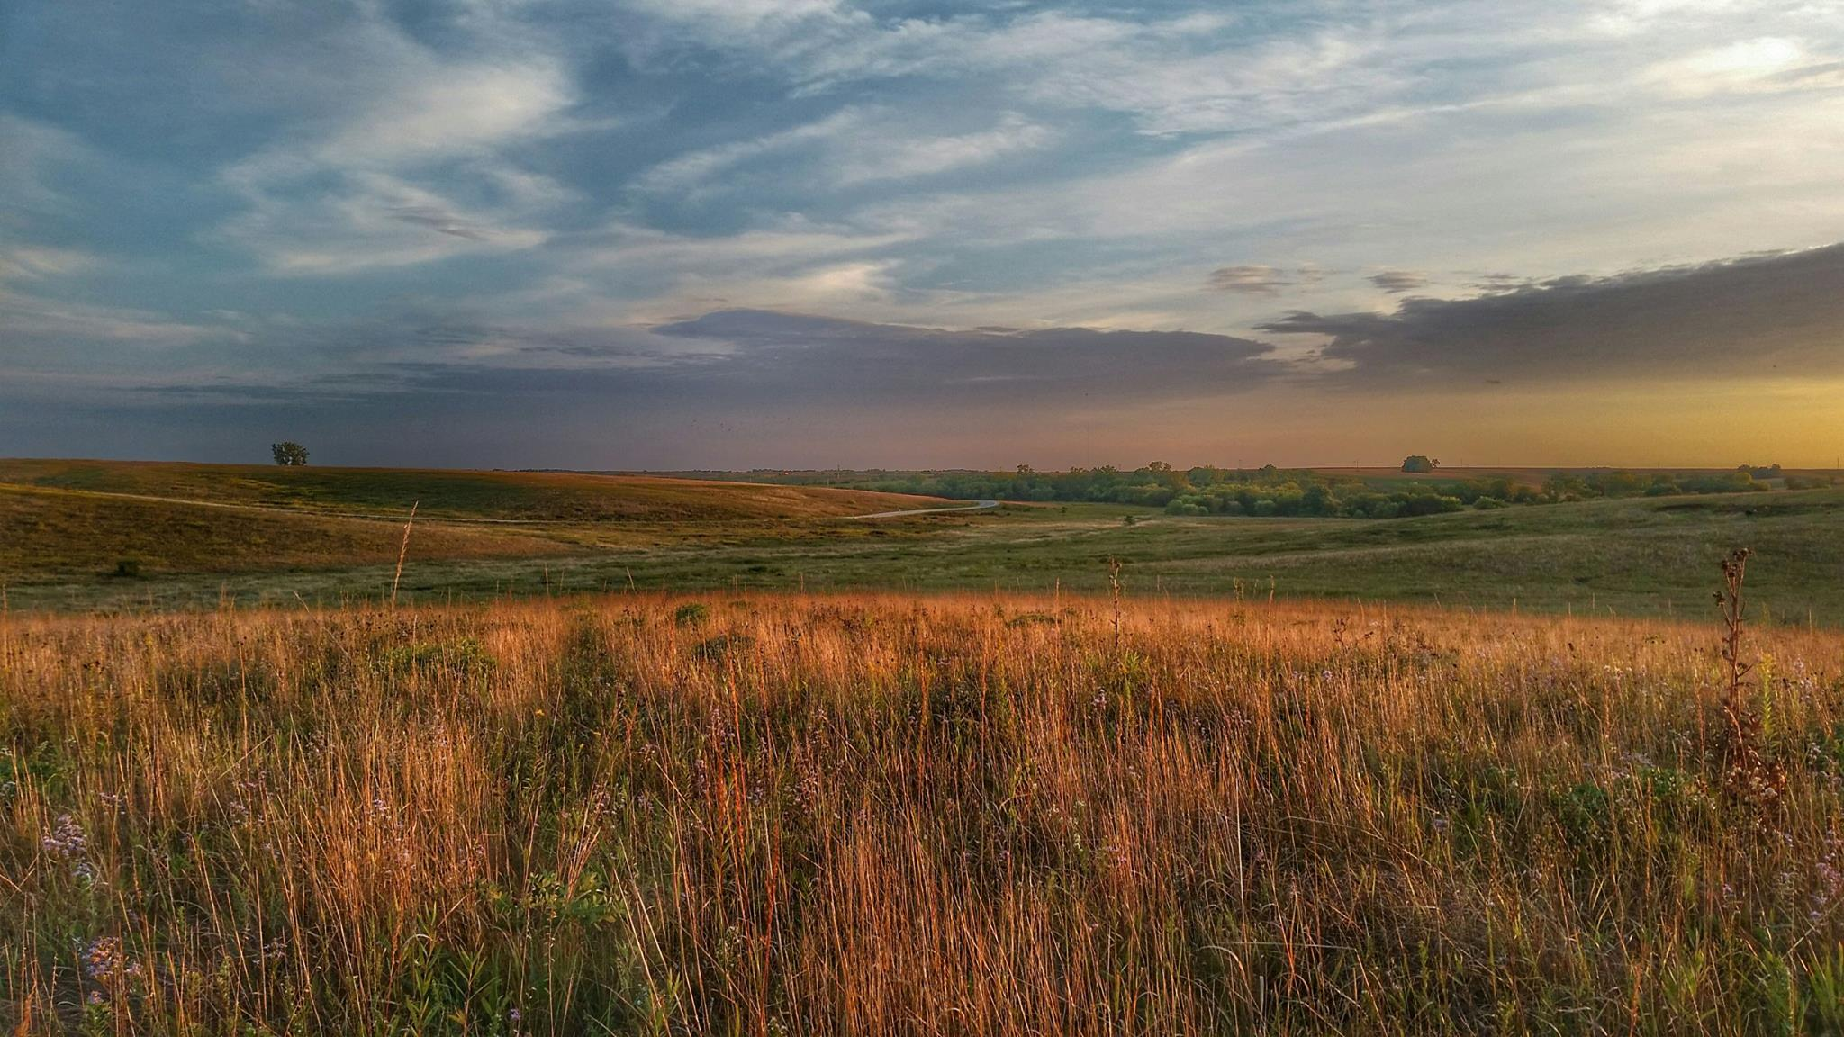

Slide 8
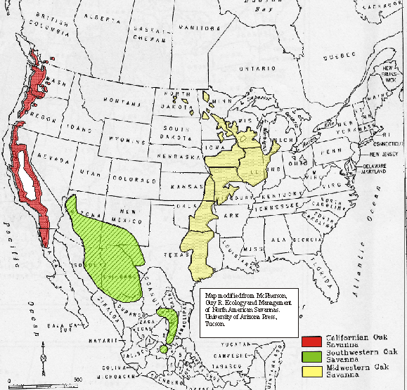
~12,000,000 ha in the Midwest (Nuzzo 1986)

Slide 9
~ 12,000,000 ha
~ 2,600 ha remained
98.98 % loss
Nuzzo 1986

Slide 10
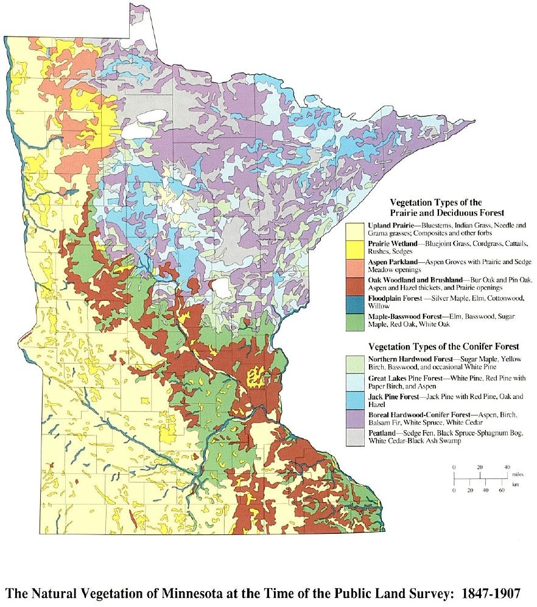
Upland Prairie
Prairie Woodland
Aspen Parkland
Oak Woodland and Brushland
Floodplain Forest
Maple – Basswood Forest
Northern Hardwood Forest
Great Lakes Pine Forest
Jack Pine Forest
Boreal Hardwood - Conifer
Peatland
The Natural Vegetation at the Time of the Public Land Survey: 1847-1907
Adapted by Barbara Coffin from The Original Vegetation of Minnesota by F. J. Marschner, pub. 1974.

Slide 11
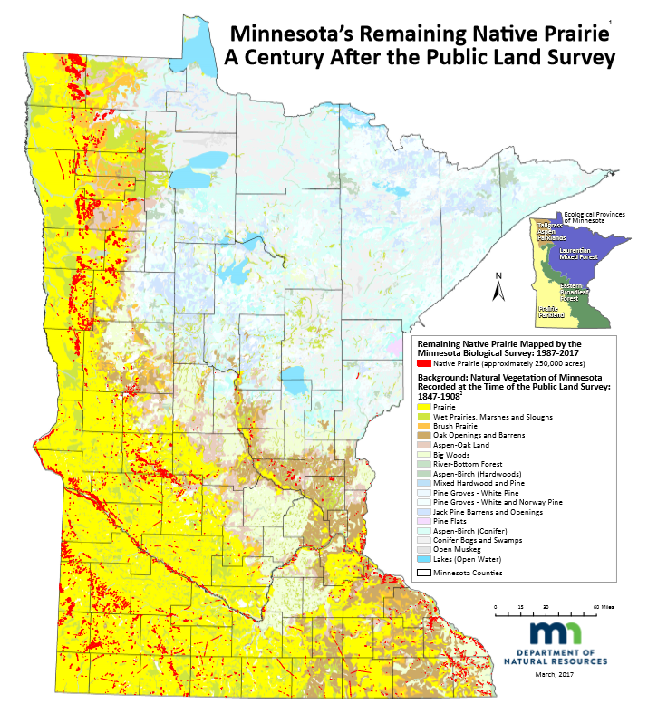

Slide 12
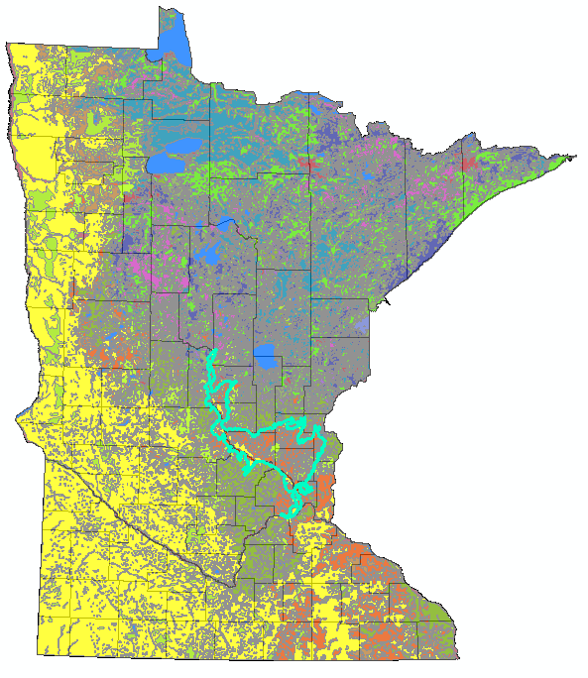
Anoka Sand Plain

Slide 13
2006 State Wildlife Action Plan
Anoka Sand Plain
High-quality oak savanna, prairie, and dune
97 Species in Greatest Conservation Need
39 federally or state listed species
Rare species occurrence tied to conservation management lands

Slide 14
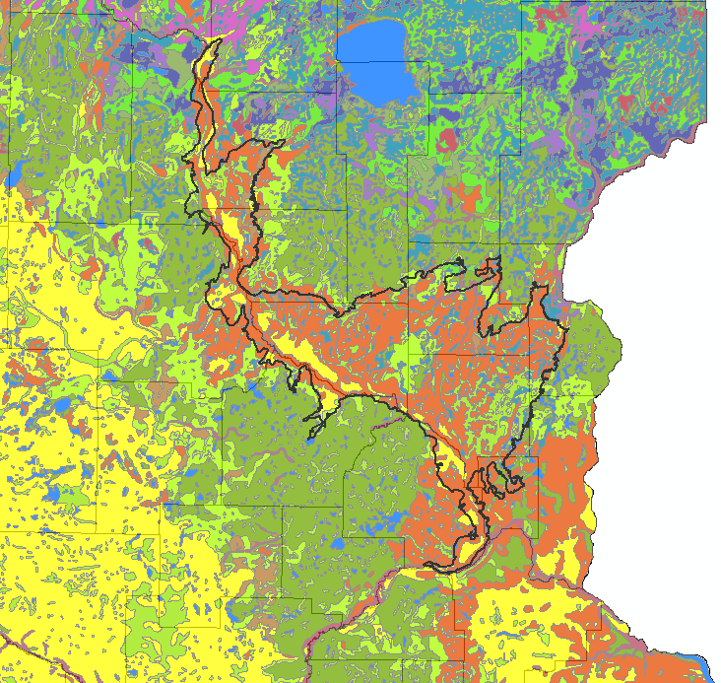
Anoka Sand Plain

Slide 15
Anoka Sand Plain

Slide 16
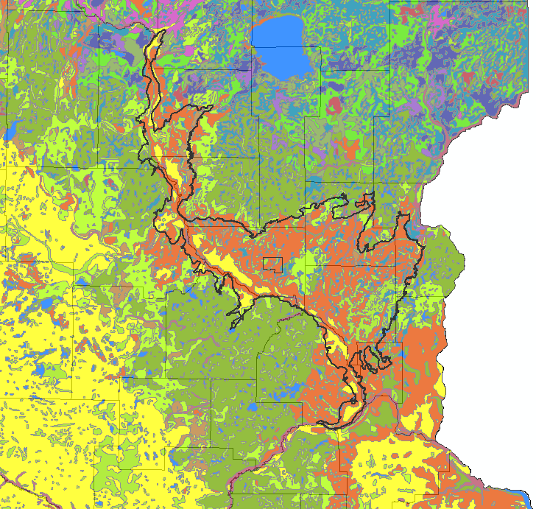
Sand Dunes State Forest
Notes:
Located in central Sherburne county within the Anoka Sand Plain subsection.

Slide 17
2006 State Wildlife Action Plan
Anoka Sand Plain
Key challenges for rare species:
Habitat loss
Habitat fragmentation
Habitat degradation
Notes:
In recognizing these challenges, the DNR also saw an opportunity for conservation. <<cut to Sand Dunes>>

Slide 18
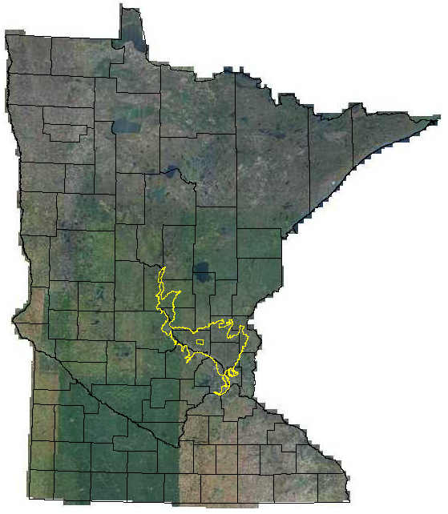
Anoka sand plain

Slide 19
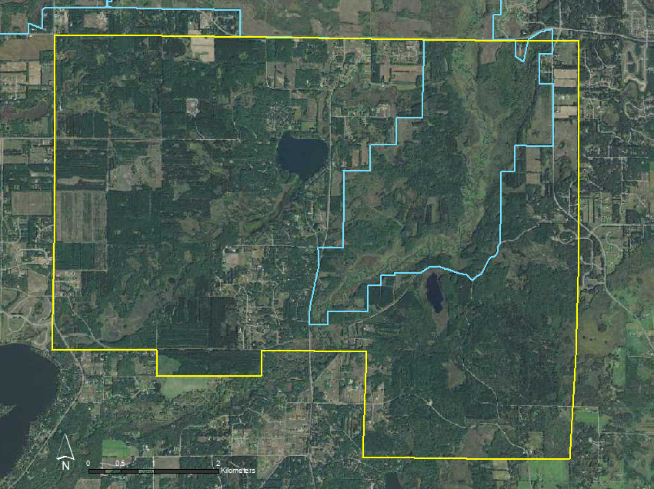
Notes:
Acquired by MN DNR in 1946, encompasses approx. 4,486ha. Managed primarily for recreation and timber production. Pines were planted in the area even before it was state owned to help stabilize dunes and soils during drought years, and have been planted since then because it’s a great area for growing pine for timber.

Slide 20
Sand Dunes State Forest
Rare features.

Slide 22
Sand Dunes Habitat Restoration
Increase available habitat
Improve habitat quality and connectivity
Permanently manage for rare plant and animal species

Slide 23
Sand Dunes Habitat Restoration
Ecologically appropriate native plant communities
Immediate Conversion Areas: 255 ha
Eventual Conversion Areas: 537 ha

Slide 24
Sand Dunes Habitat Restoration
Prescribed burning
Selective timber harvest
Invasive species control

Slide 25
Sand Dunes State Forest

Slide 26
Sand Dunes State Forest
Immediate Conversion Areas:
255 ha

Slide 27
Sand Dunes State Forest
Immediate Conversion Areas:
255 ha
Eventual Conversion Areas:
537 ha

Slide 28
Sand Dunes Habitat Restoration
Rare features management on varying spatial and temporal scales
Broad ecosystem health
Notes:
The goal of this restoration was to manage the landscape for rare native species and communities, and to contribute to the overall broad-scale ecosystem health.

Slide 29


Slide 30
What constitutes success?

Slide 31
Notes:
These are species that evolved along with the native habitats that we are trying to restore. So, we can use their collective distribution, abundance, and response to management as a way to inform restoration.

Slide 32
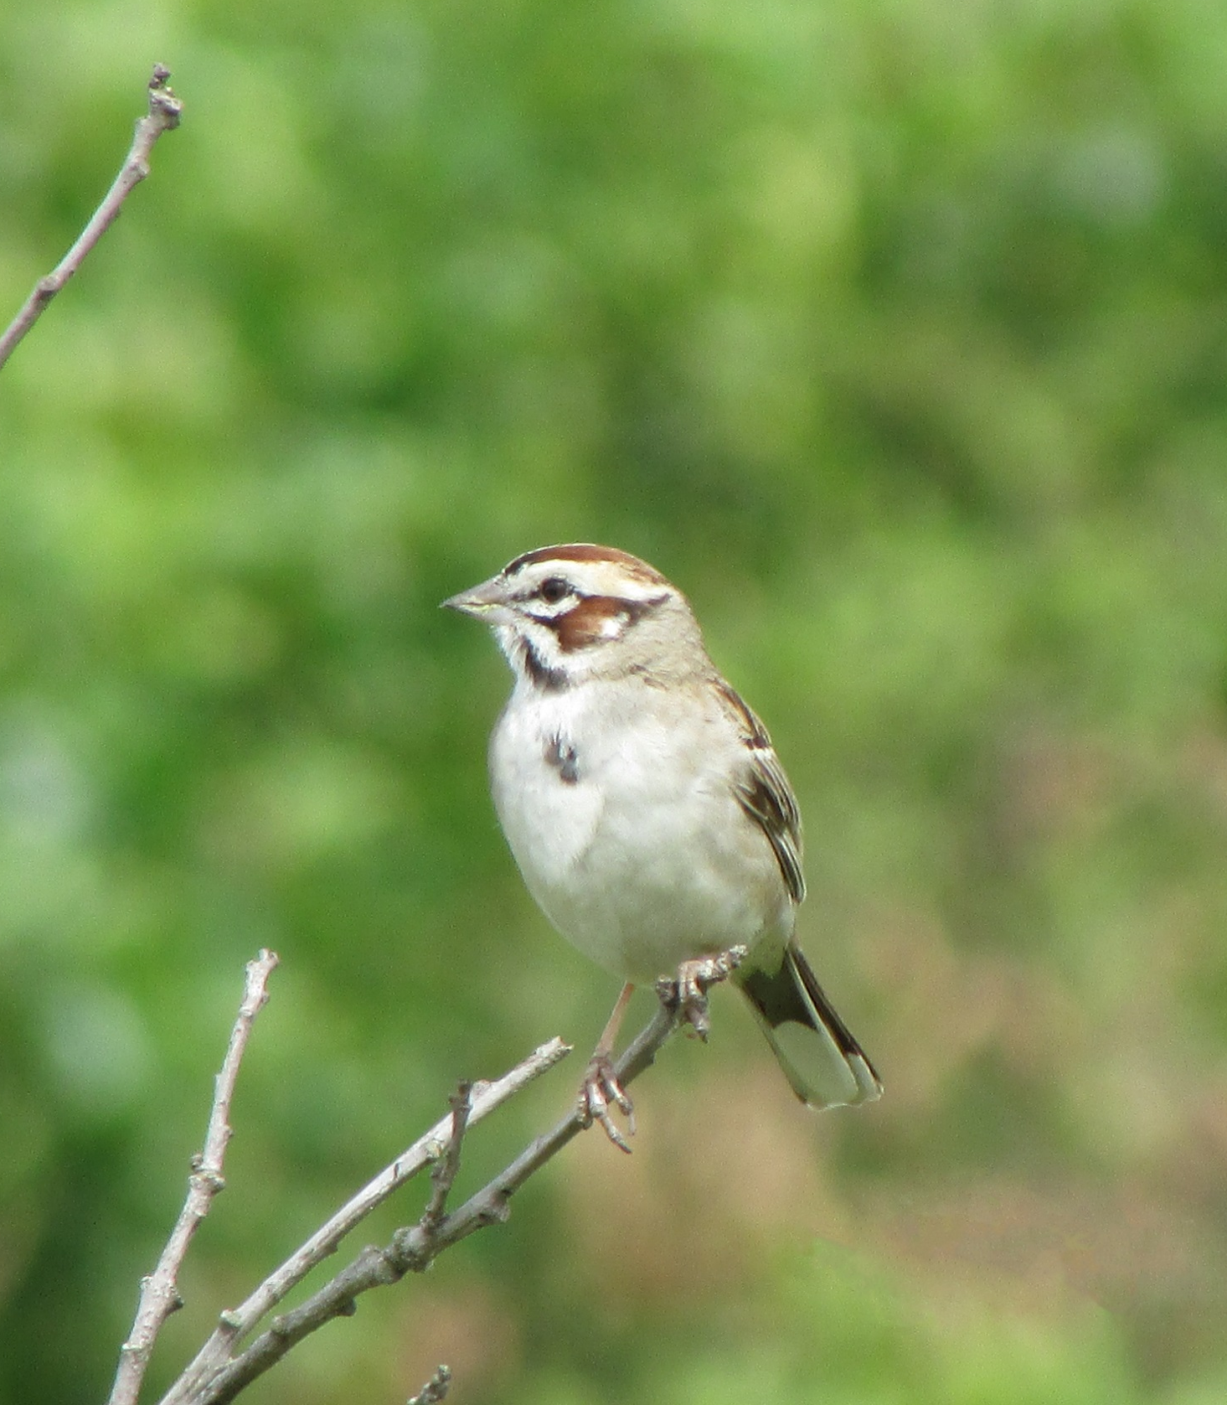
Lark Sparrow
Chondestes grammacus
SGCN
Special Concern

Slide 33
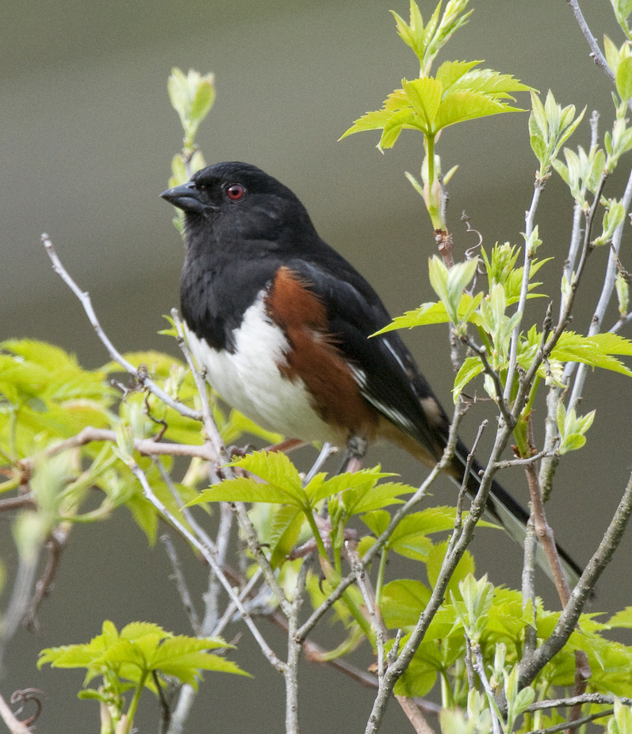
Eastern Towhee
Pipilo erythrophthalmus

Slide 34

Leonard’s Skipper
Hesperia leonardus
SGCN
Special Concern

Slide 35
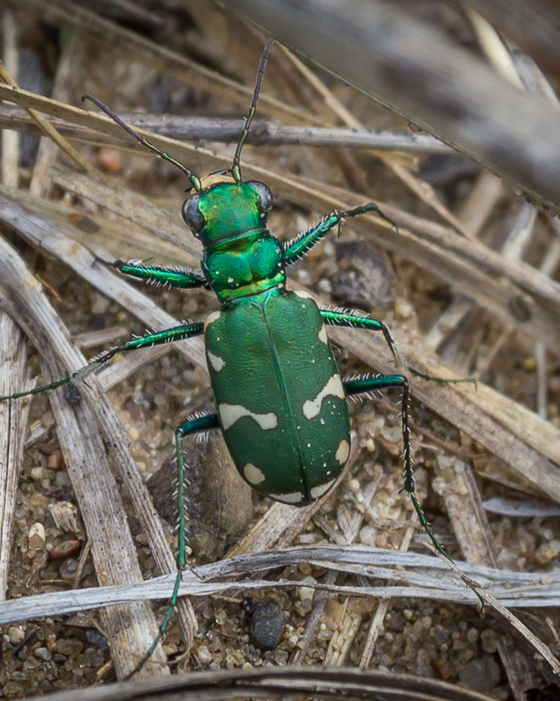
Northern Barrens Tiger Beetle
Cicindela patruela patruela
SGCN
Special Concern
Photo Credit: Brett Whaley

Slide 36
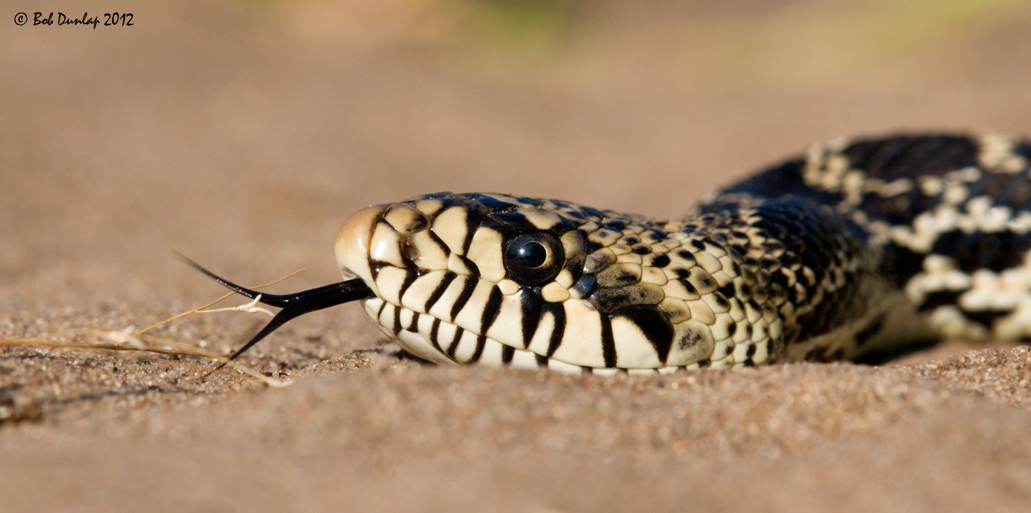
Gophersnake
Pituophis catenifer
SGCN

Slide 37
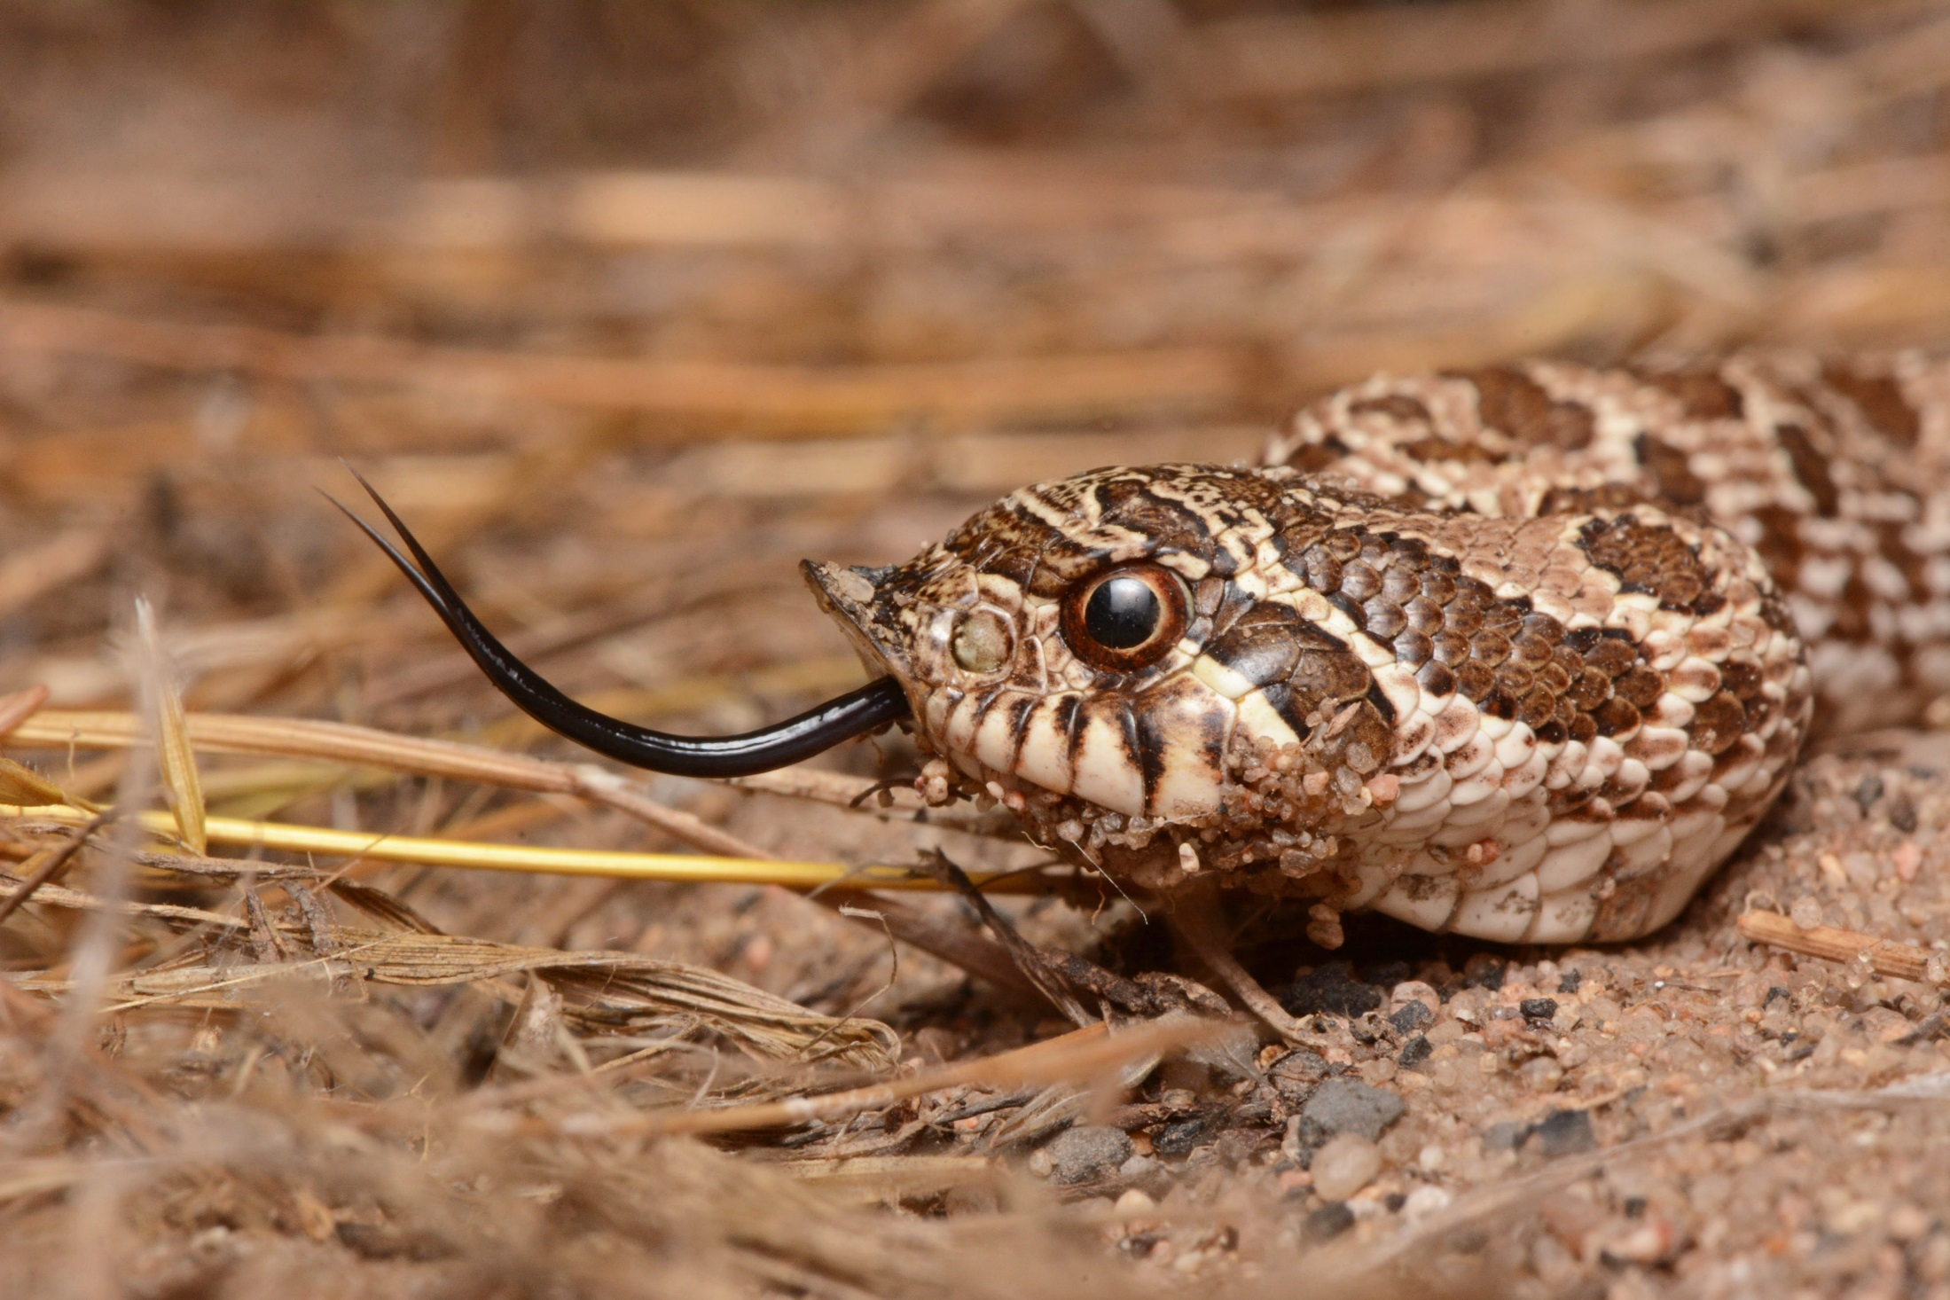
Plains Hognose Snake
Heterodon nasicus
SGCN
Special Concern
Photo Credit: Andrew DuBois

Slide 38
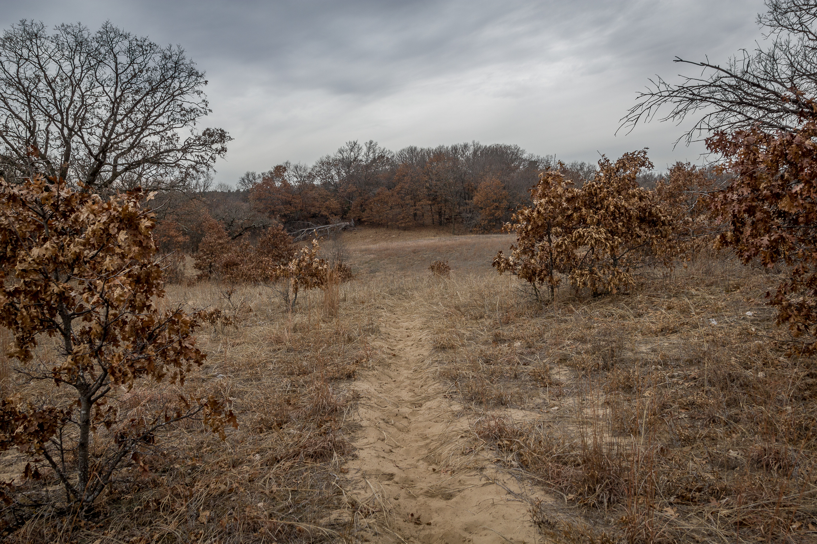
Photo Credit: Brett Whaley
Notes:
We can study the distribution and abundance of these species on the landscape in order to learn more about their habitat requirements, so that we know how to manage for a functional landscape that provides what they need. And that’s exactly what we did.

Slide 39
Photo Credit: Brett Whaley
What factors influence rare species occupancy and abundance on the
Anoka Sand Plain?
Notes:
Our specific research question was, what factors influence rare species occupancy and abundance within the Anoka Sand Plain?

Slide 40
Notes:
Our study area included Sand Dunes State Forest, as a primary goal was to inform habitat restoration within the State Forest Itself. We also included surveys within adjacent Sherburne WMA to add some elements of desired future conditions to our analyses.

Slide 41
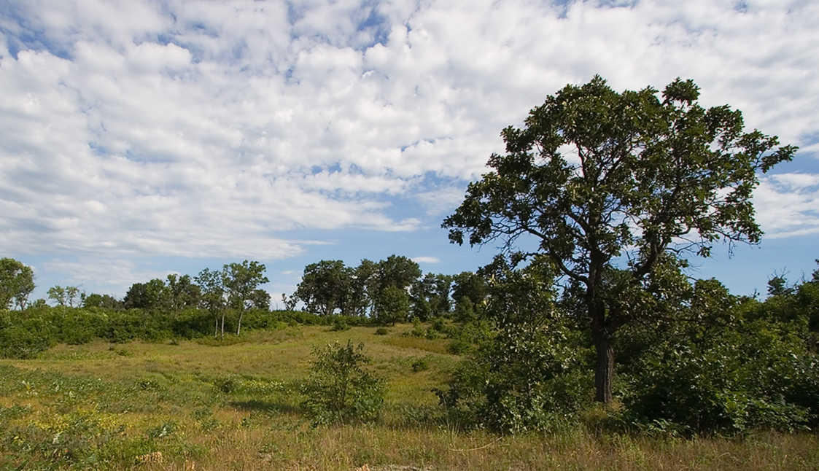
Sherburne National Wildlife Refuge
Notes:
Sherburne is directly North of sand dunes, and has been managed for wildlife since the 1960s. 12,424 ha. For the purposes of our study, Sherburne contains areas that are similar to the desired future conditions at Sand Dunes, and including plots at Sherburne adds…breadth? Scope? What?

Slide 42
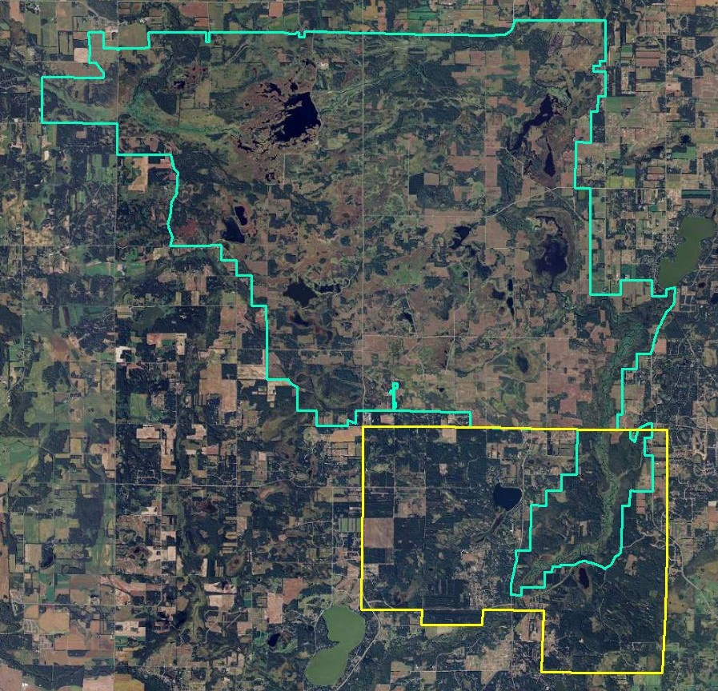
Sherburne
National Wildlife Refuge
~ 12,424 ha
Sand Dunes
State Forest
~ 4,468 ha

Slide 43
Sherburne
National Wildlife Refuge
20 Plots
Sand Dunes
State Forest
39 Plots

Slide 44
Sand Dunes
State Forest
39 Plots
Immediate Conversion Areas
9 Plots

Slide 45
Surveys : All Species
Occupancy
Relative abundance
Unmarked individuals
Notes:
If you’re surveying something that you’ll likely only encounter in small numbers in a modest fraction of your plots, Occupancy Modeling allows you to make inferences from that limited data. Relative abundance can give you more / slightly different information, if your data are sufficient. The real strength of both of these analysis methods is that they allow you to make population level inferences based on observations of unmarked individuals.

Slide 46
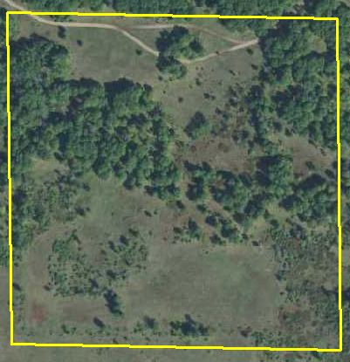
Notes:
The basic premise is that when you visit a site you either detect the species or you don’t.

Slide 47
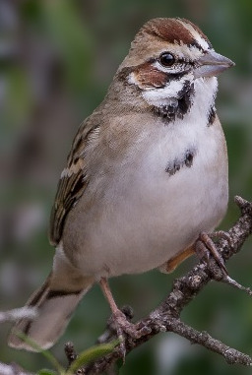
1 = Detected
Notes:
This is recorded as a 1 for detection

Slide 48
1 = Detected
0 = Not Detected
Notes:
Or a 0 for non-detection. The process is then repeated. In this study we generated repeat observations in two ways; by having 3 temporally adjacent survey periods and by repeating the survey at least twice a year.

Slide 49
Notes:
So, here I am in plot 4.

Slide 50
May 21
Notes:
So, here I am in plot 4.
It’s May 21st, it’s a beautiful morning

Slide 51
May 21
1
Notes:
and I hear a Lark Sparrow during the first period of my point count.

Slide 52
May 21
1 0
Notes:
I hear none during the second period,

Slide 53
May 21
1 0 1
Notes:
Then two Lark Sparrows during the third period. Note that the two sparrows still only get recorded as a 1, for ‘detected.’

Slide 54
May 21
June 10
1 0 1
Notes:
I come back on June 10th, it’s my birthday, I’m feeling lucky…..

Slide 55
May 21
June 10
1 0 1
0 0 0
Notes:
And I don’t hear anything.

Slide 56
May 21
June 10
1 0 1
0 0 0
May 24
June 17
0 0 1
1 0 1
Notes:
The process is then repeated the following year.

Slide 57
May 21
June 10
1 0 1
0 0 0
May 24
June 17
0 0 1
1 0 1
2015
2016
Encounter History:
1 0 1 0 0 0
0 0 1 1 0 1
Notes:
The result is a binary encounter history that we are able to analyze in order to make inferences about occupancy and detection probability. It’s important to remember that the zeros don’t represent absences, they represent non-detections. We don’t know if the species was there; all we know is whether or not we detected it.

Slide 58
Occupancy
May 21
June 10
1 0 1
0 0 0
May 24
June 17
0 0 1
1 0 1
2015
2016
Encounter History:
1 0 1 0 0 0
0 0 1 1 0 1
Notes:
So, that’s occupancy data in a nutshell. But what about those two sparrows I encountered on May 21? What if I have many instances where I encounter multiple individuals per period? Isn’t that information essentially getting diluted or lost?

Slide 59
May 21
June 10
3 0 1
0 0 0
May 24
June 17
0 0 3
7 0 4
Notes:
The short answer is yes. What if my data looked like this? Instead of detection/non-detection, I have some count data listed here.

Slide 60
May 21
June 10
3 0 1
0 0 0
May 24
June 17
0 0 3
7 0 4
2015
2016
Encounter History:
1 0 1 0 0 0
0 0 1 1 0 1
Notes:
With occupancy modeling, all of those counts get reduced to 1’s and 0’s, detections and non-detections.

Slide 61
Abundance
May 21
June 10
3 0 1
0 0 0
May 24
June 17
0 0 3
7 0 4
2015
2016
Count History:
3 0 1 0 0 0
0 0 3 7 0 4
Notes:
A better solution here might be Abundance Modeling with N-Mixture Models. These are very similar to Occupancy Models, but they deal with repeated counts of individuals instead of just repeated detections and non-detections. With N-Mixture models we can still estimate probability of occupancy, but we’re also able to estimate expected abundance of occupied plots. If our dataset is sufficient, this can give us a little more bang for our buck in terms of informing management.

Slide 62
Surveys : Birds
Point Counts
3, 3-minute intervals per count
2x per plot, per year, 2015 - 2016
Notes:
We surveyed each plot for our target species over 2 or 3 field seasons between 2014-2016.

Slide 63
Surveys : Invertebrates and Snakes
Targeted wandering transects
3 timed intervals per count
At least 2x per plot, per year,
2015 - 2016
Notes:
We surveyed each plot for our target species over 2 or 3 field seasons between 2014-2016.

Slide 64
Surveys : Habitat Variables
3-5 sites per plot
1m radius
Averaged over entire plot

Slide 65
Analysis
N-mixture models (Royle 2004)
Open population (Dail and Madsen 2011)
Other distributions (Hostetler and Chandler 2015)
(excess zeroes)

Slide 66
N-mixture model assumptions
Population closure
Constant detection probability
Counts are binomial random variables

Slide 67
Analysis

Slide 68
Analysis: Birds
Package unmarked in Program R
Single variable N-mixture Abundance Models
Supported covariates included in a final multi-variate model

Slide 69
Analysis: Snakes
Insufficient data for analysis

Slide 70
Analysis: Invertebrates
Package unmarked in Program R
Single variable N-mixture Abundance Models
Single variable occupancy models

Slide 71
Analysis: Invertebrates
Assumption violations:
Population closure
Constant detection probability

Slide 72
Analysis: Invertebrates
Bayesian methodology, jagsUI:
Population closure
Plot-level mean abundance, subsequent abundance was variable with random error

Slide 73
Analysis: Invertebrates
Bayesian methodology, jagsUI:
Detection probability
Beta-binomial distribution to allow detection to vary by plot, survey, and survey replicate

Slide 74
Results

Slide 75
Results: Lark Sparrow
Detected in 18 of 59 plots

Slide 76
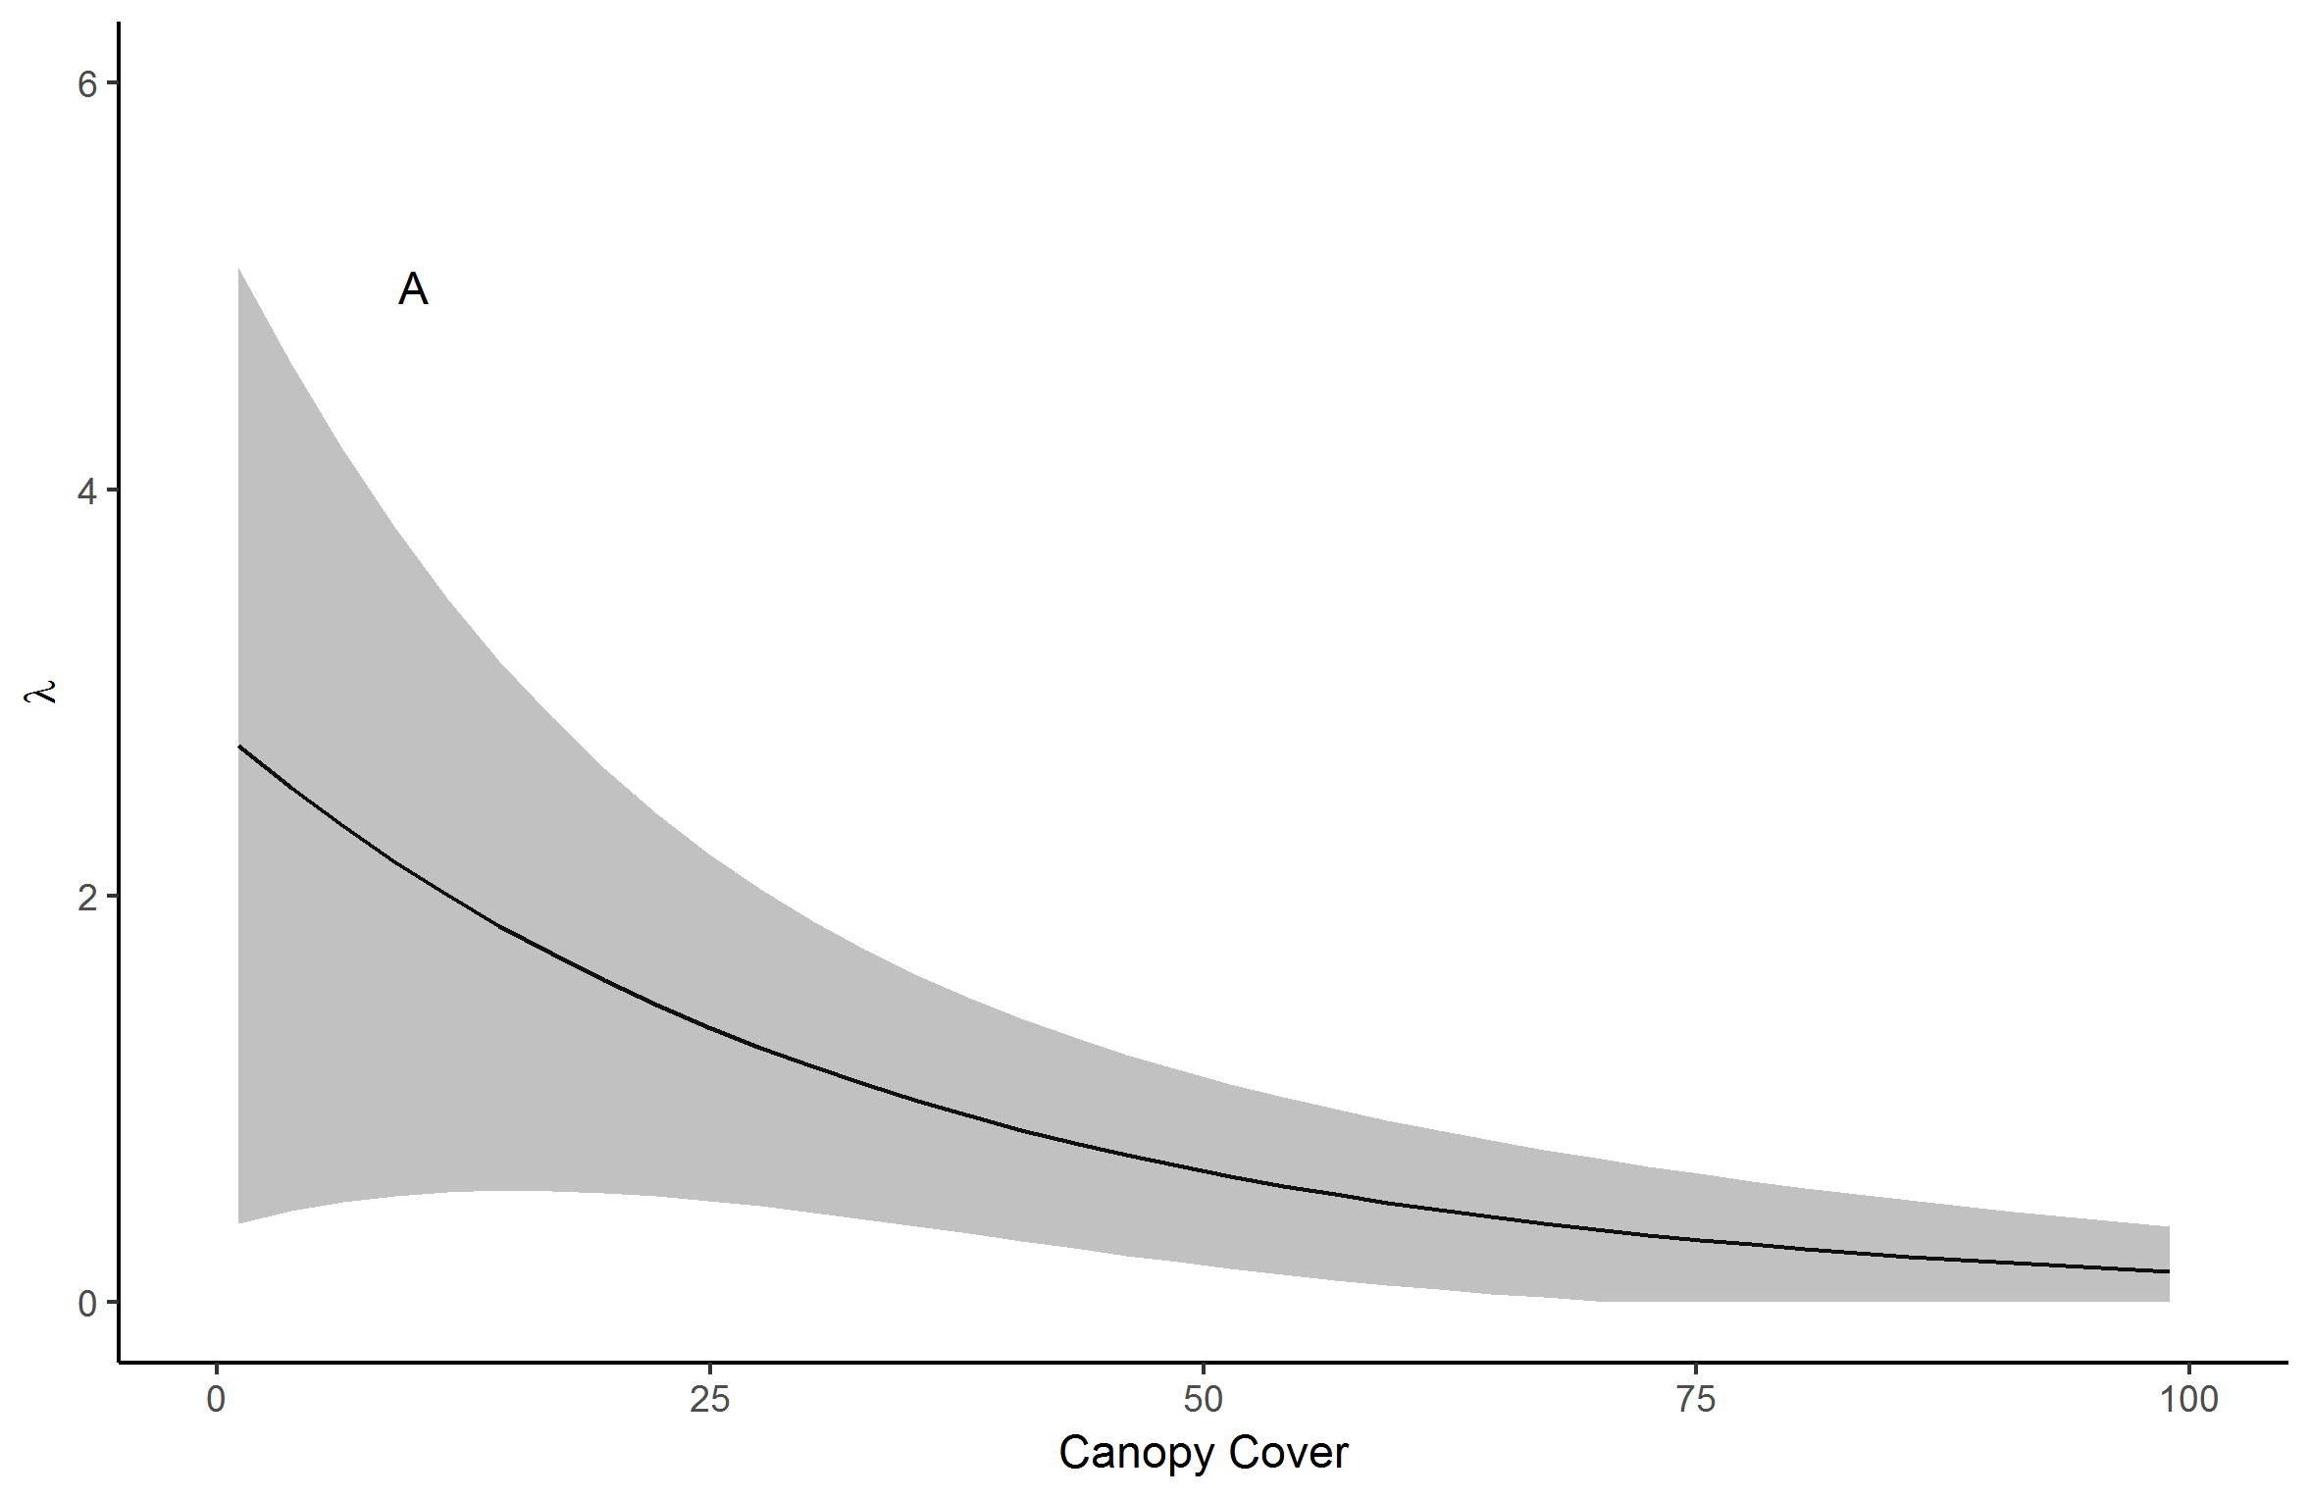
Results: Lark Sparrow

Slide 77
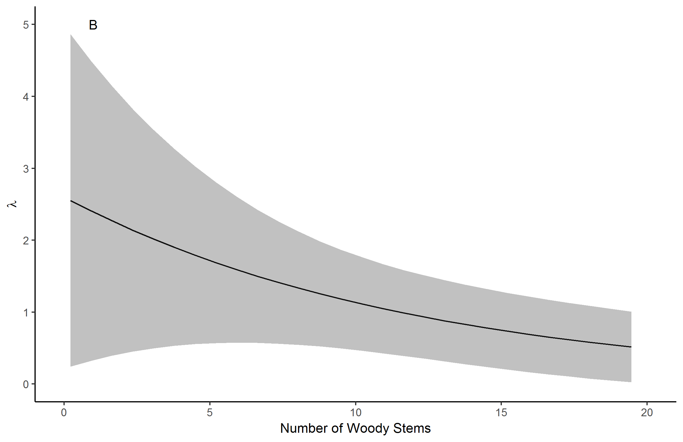
Results: Lark Sparrow

Slide 78
Results: Eastern Towhee
Detected in 58 of 59 plots

Slide 79
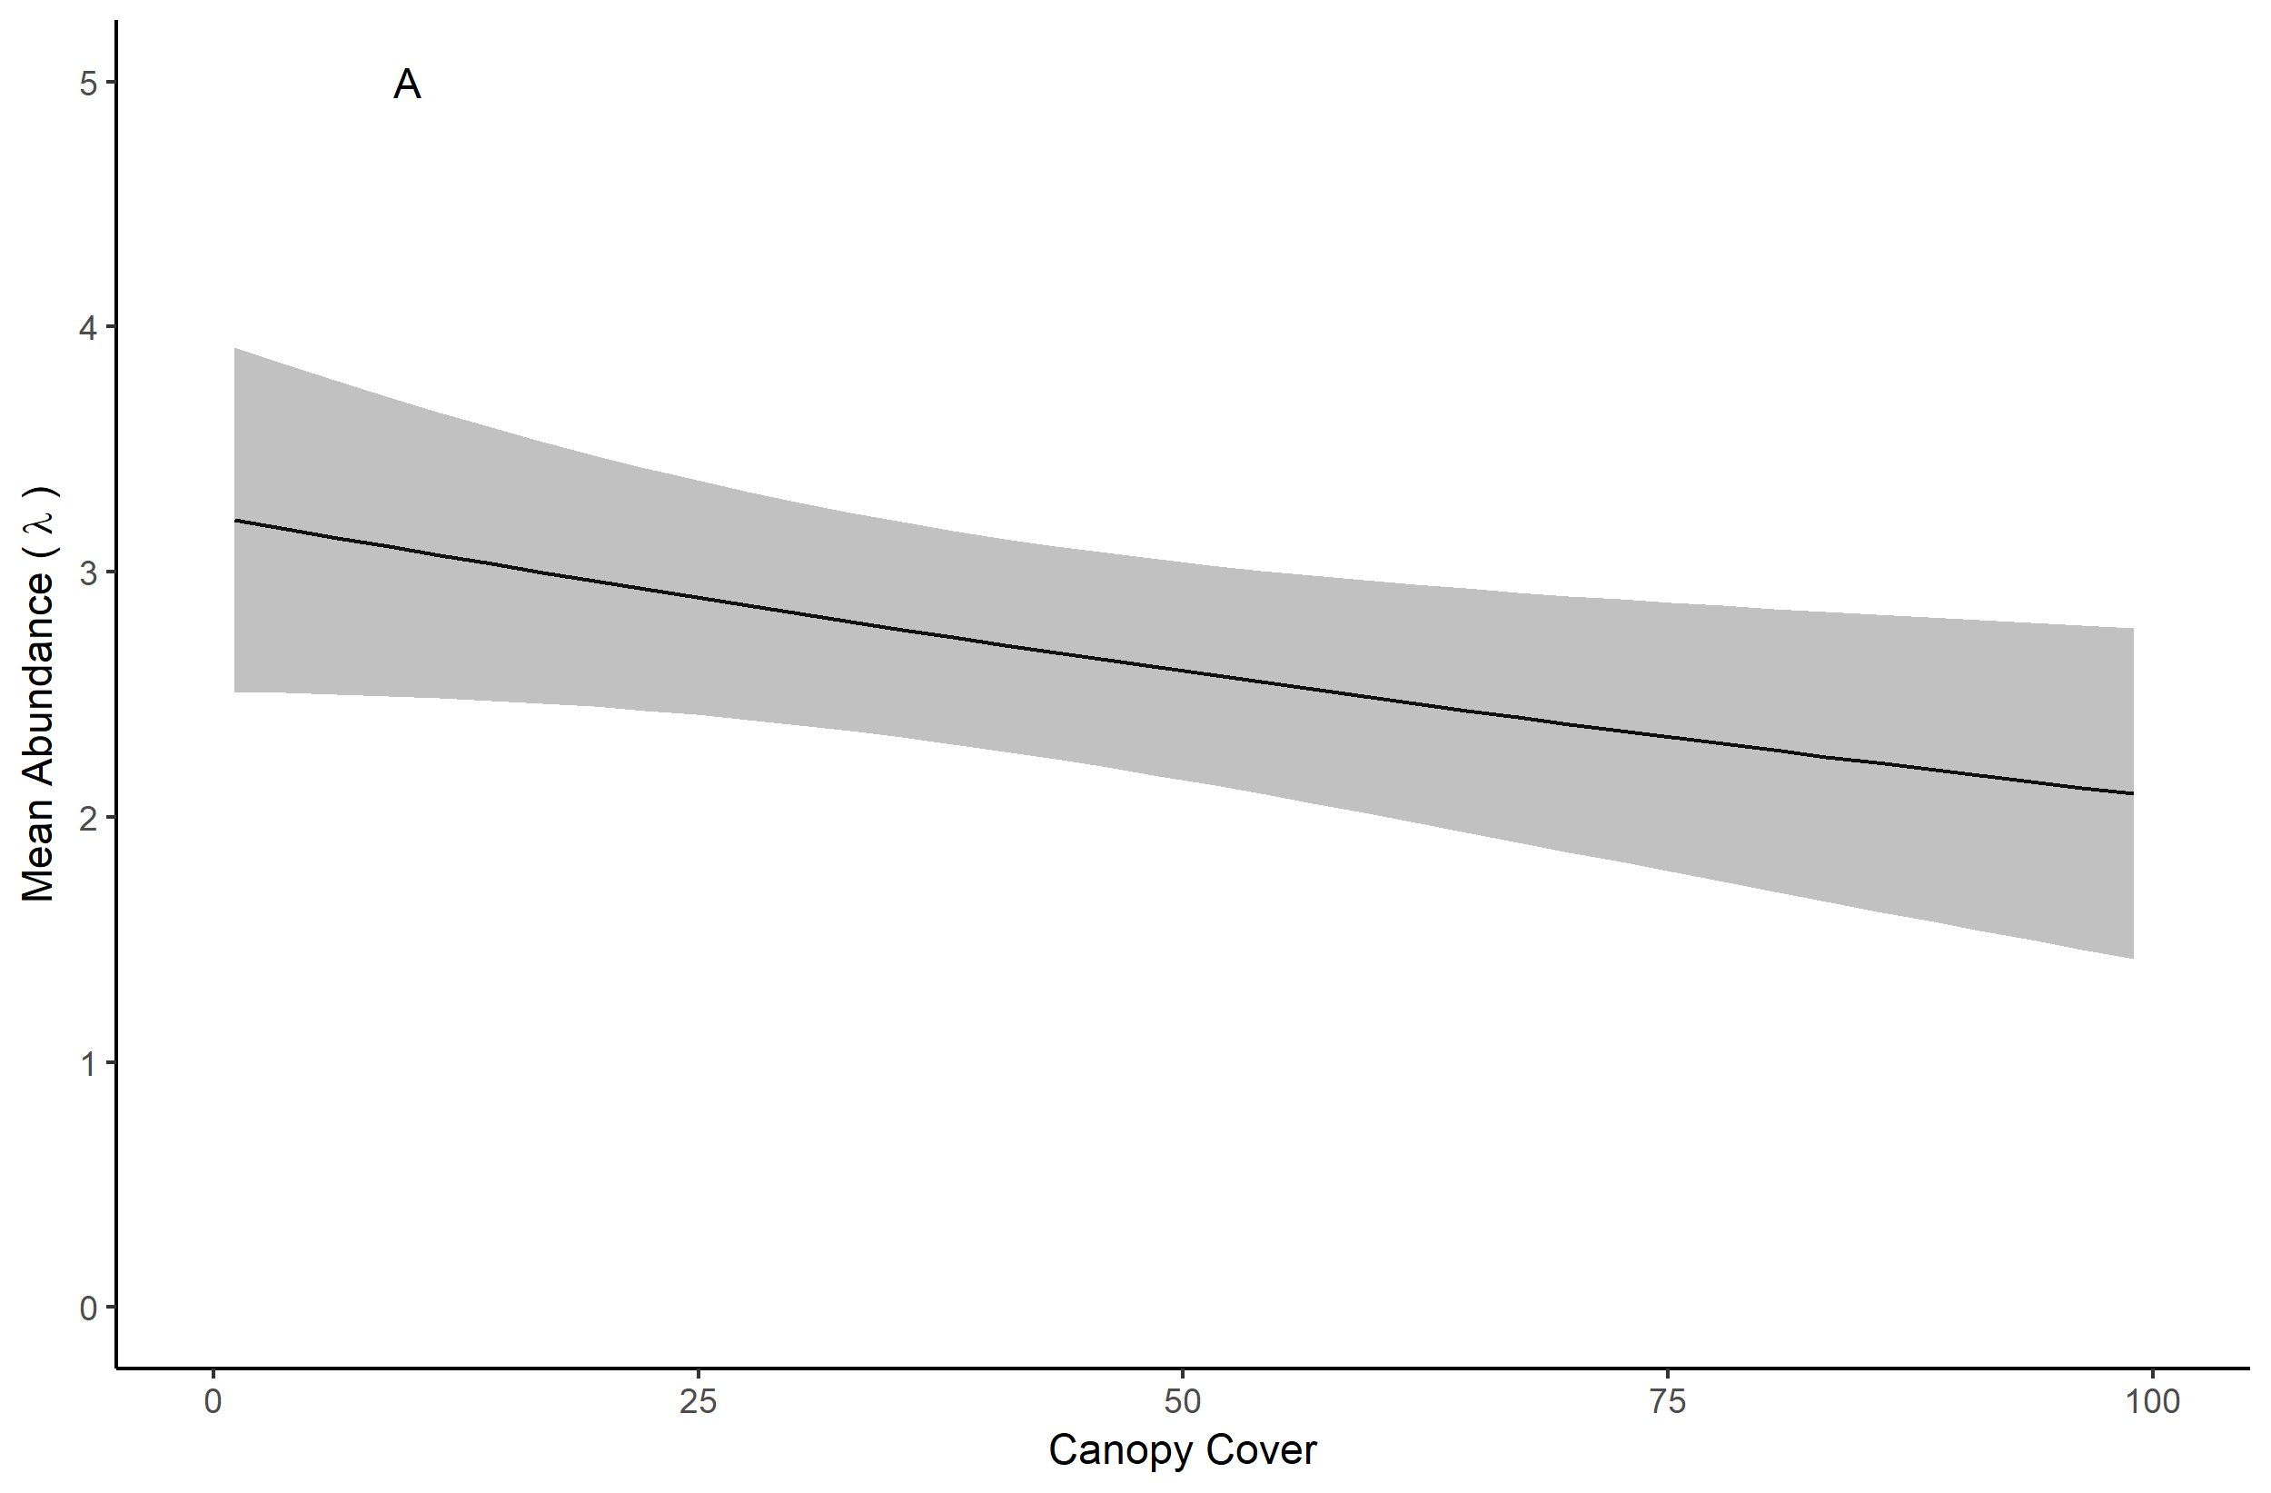
Results: Eastern Towhee

Slide 80
Results: Leonard’s Skipper
Detected in 10 of 59 plots

Slide 81
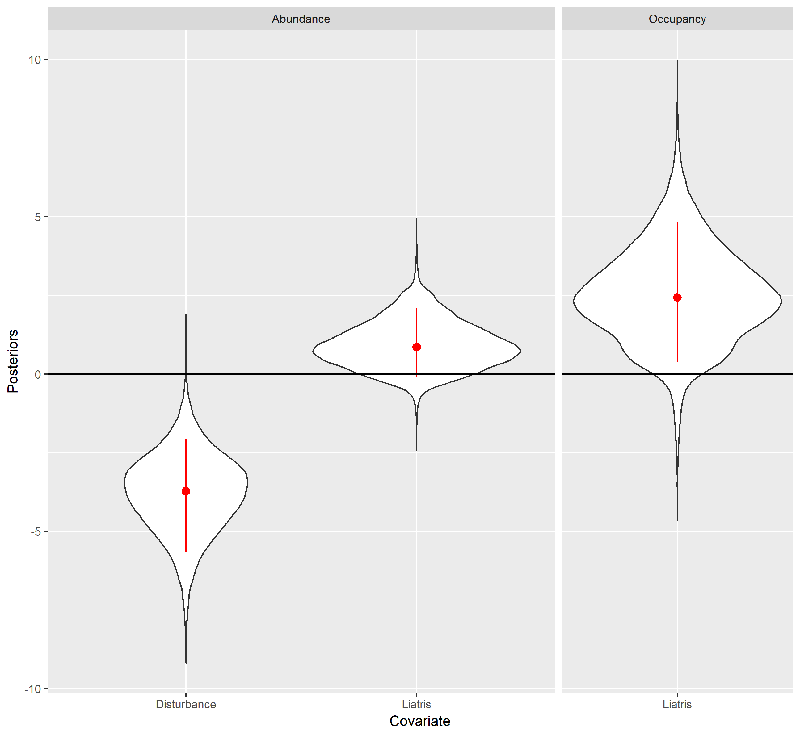
Results: Leonard’s Skipper

Slide 82
Results: Tiger Beetle
Detected in 27 of 59 plots

Slide 83
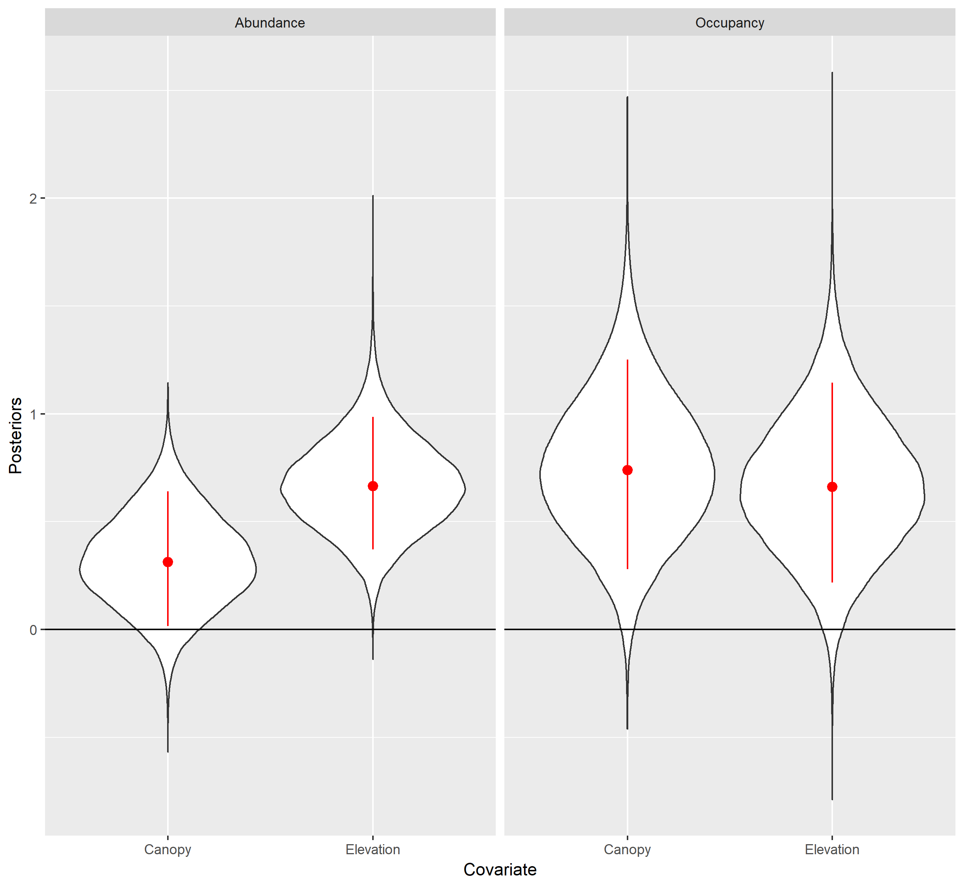
Results: Tiger Beetle

Slide 84
Discussion

Slide 85
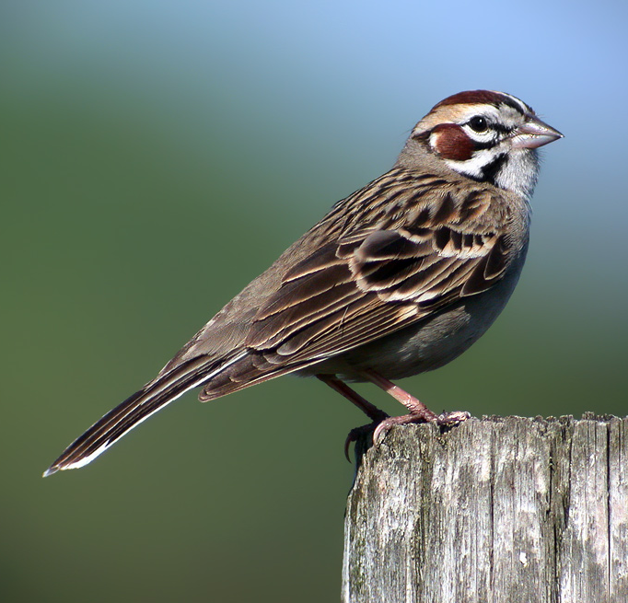
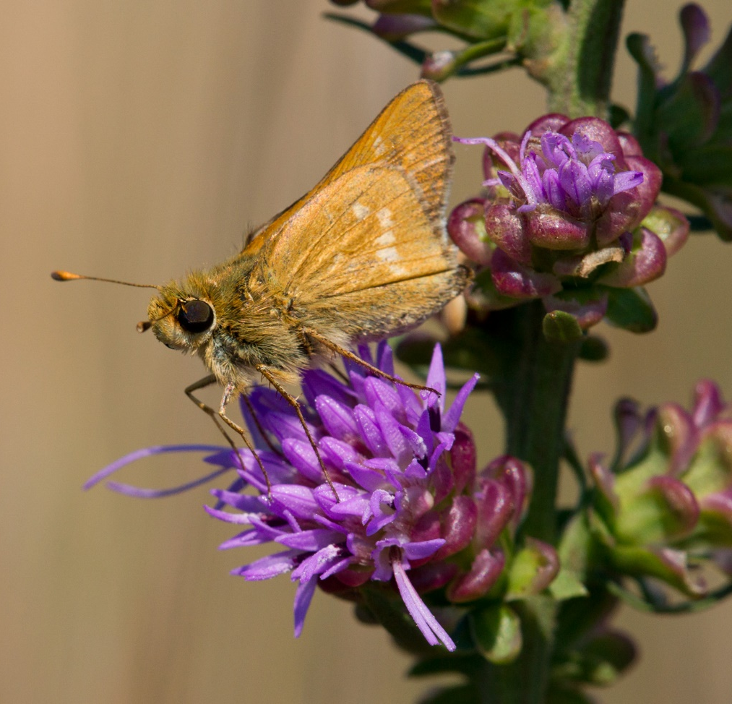
Discussion

Slide 86

Discussion
+ disturbance
- disturbance
- canopy
+ liatris
- woody stems

Slide 87
Discussion
+ disturbance
- disturbance
- canopy
+ liatris
- woody stems

Slide 88
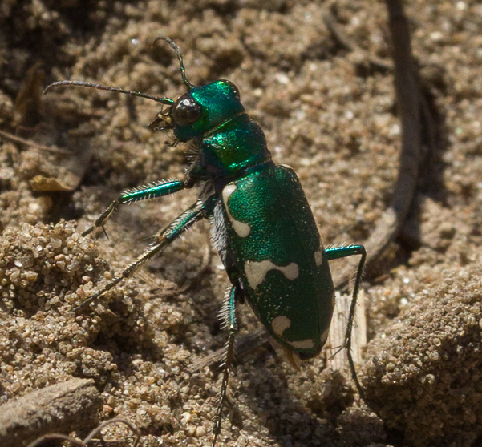
Discussion
+ disturbance
+ elevation
- canopy
+ canopy
- woody stems

Slide 89
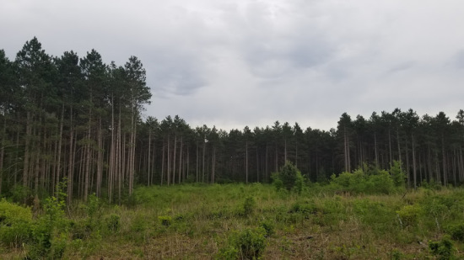

Slide 90
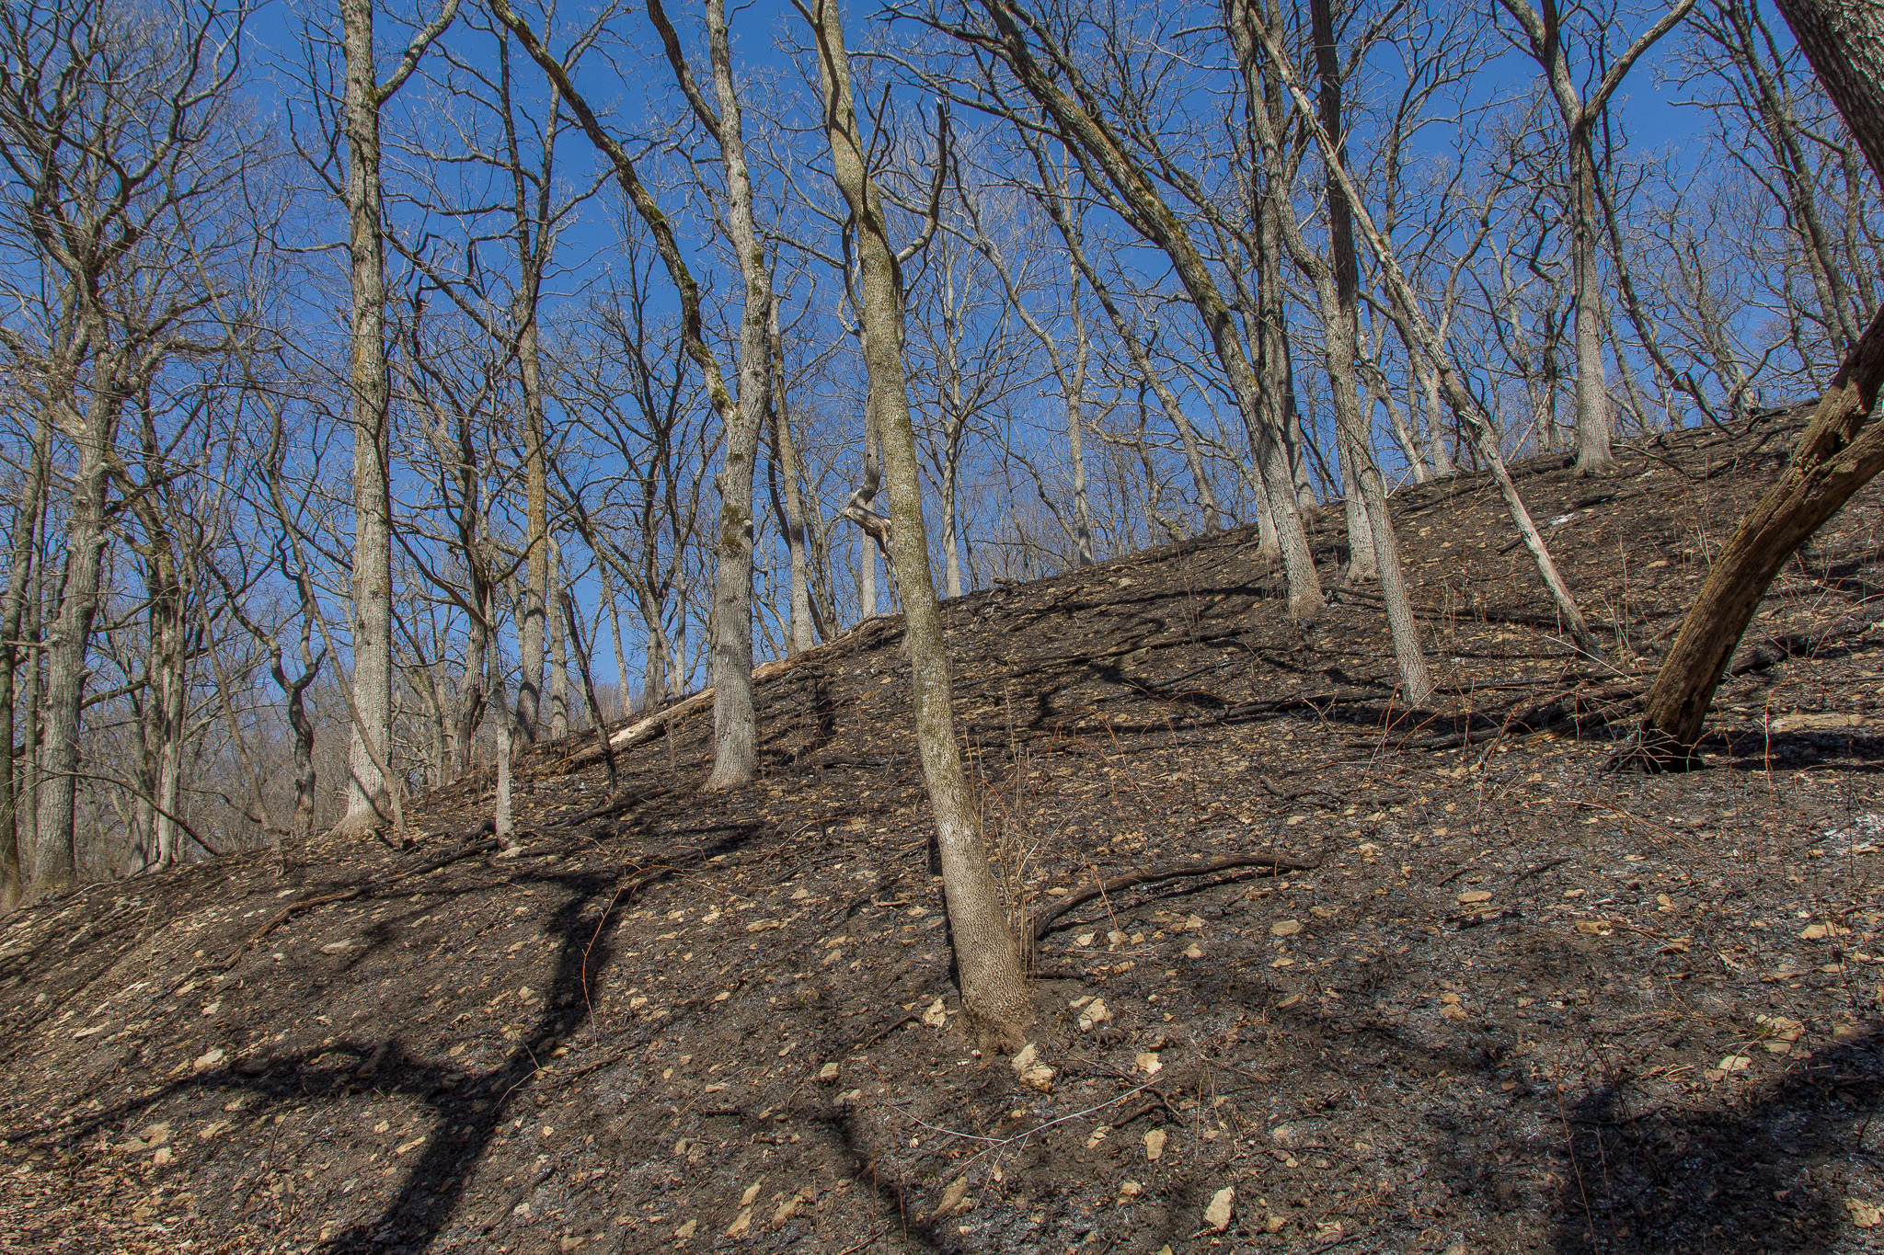

Slide 91
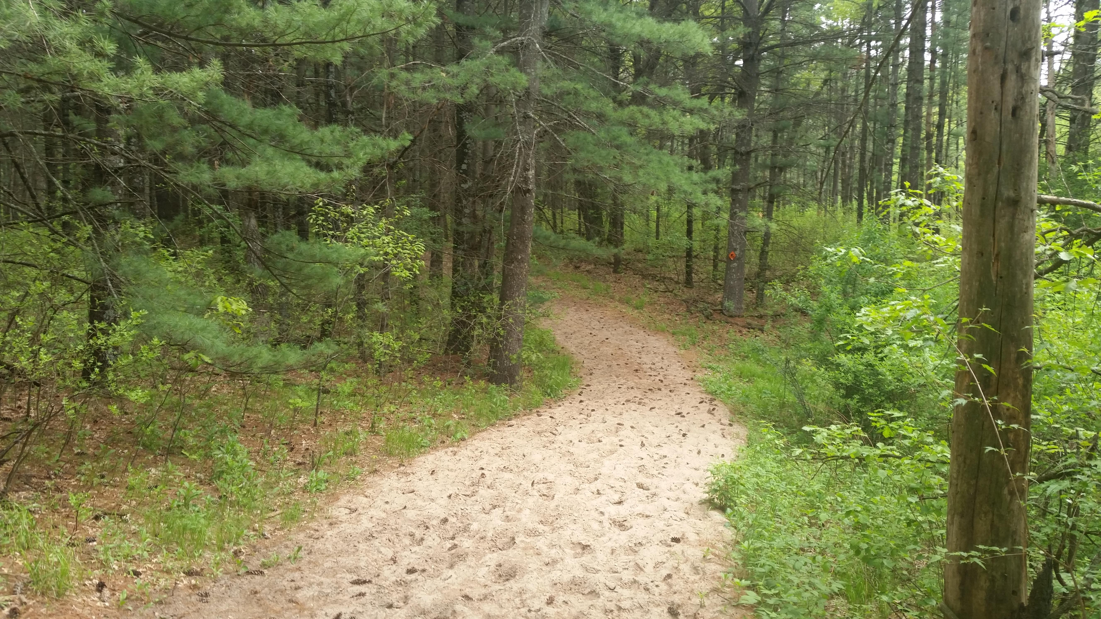

Slide 92
Notes box
Photo Credit
Twenty point text
Twenty-four point text
Twenty-eight point text
Thirty-two point text
Thirty-six point text
Forty-four point text
Forty-eight point text

Slide 93
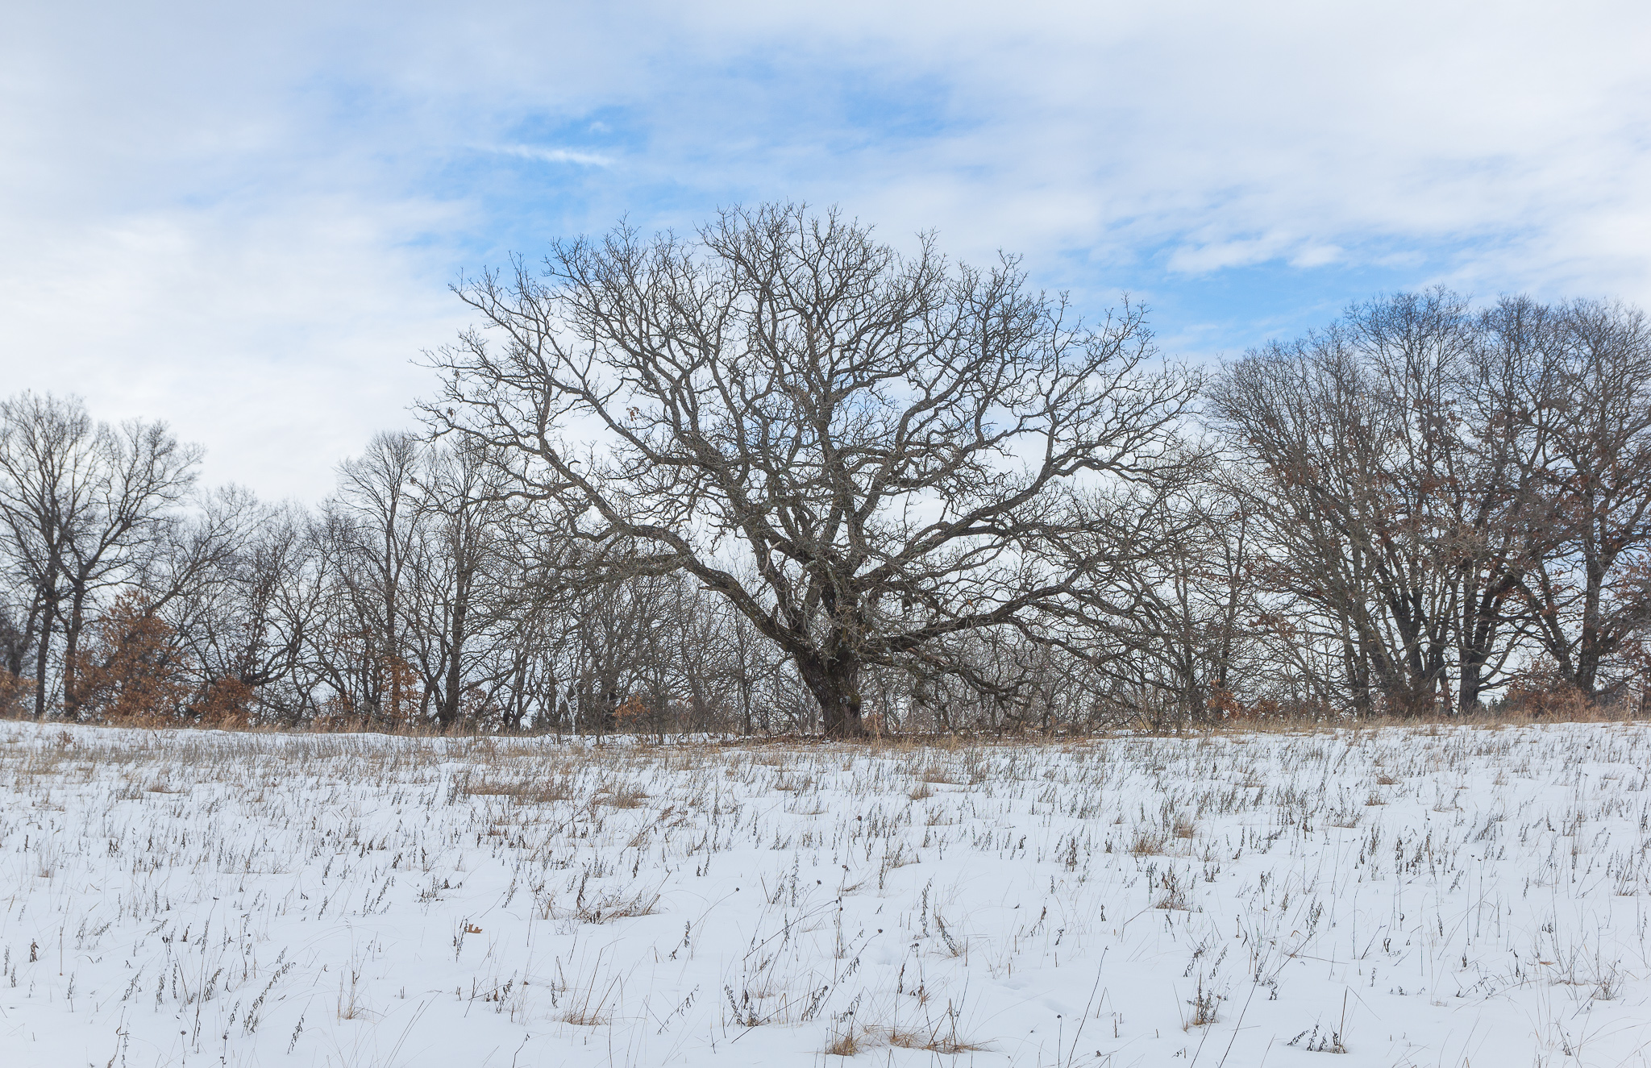

Slide 94
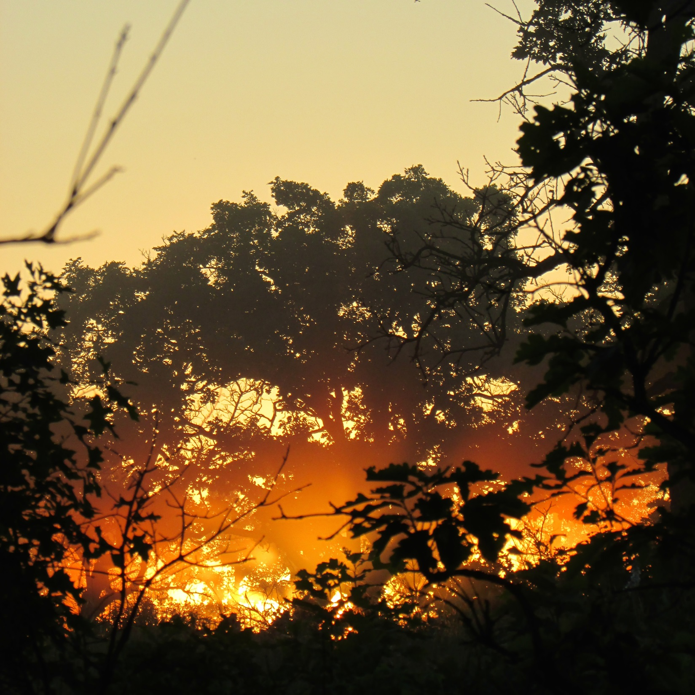

Slide 95
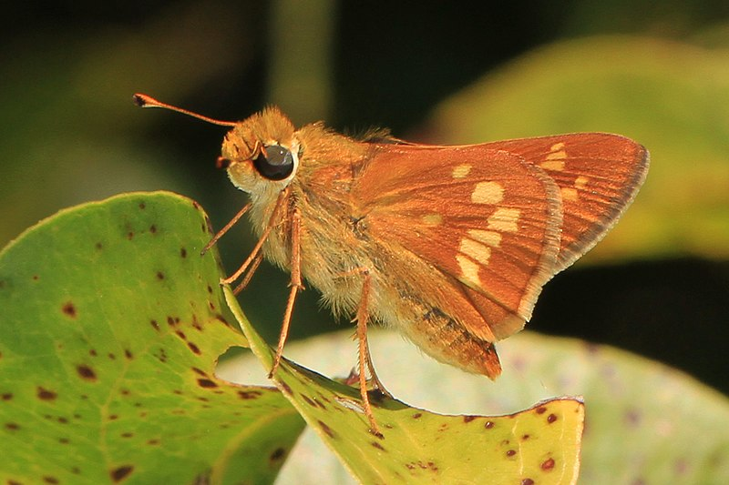
Judy Gallagher

Slide 96
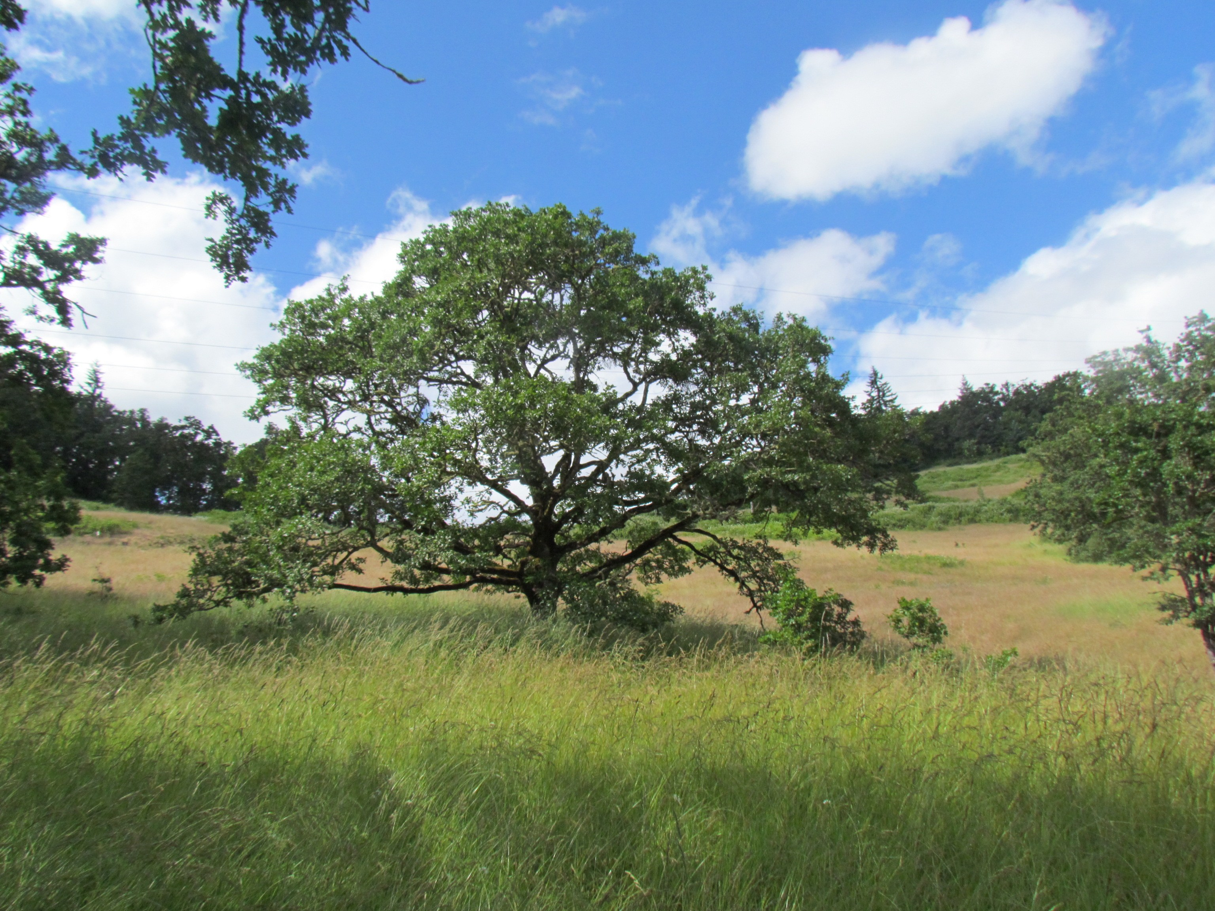

Slide 97
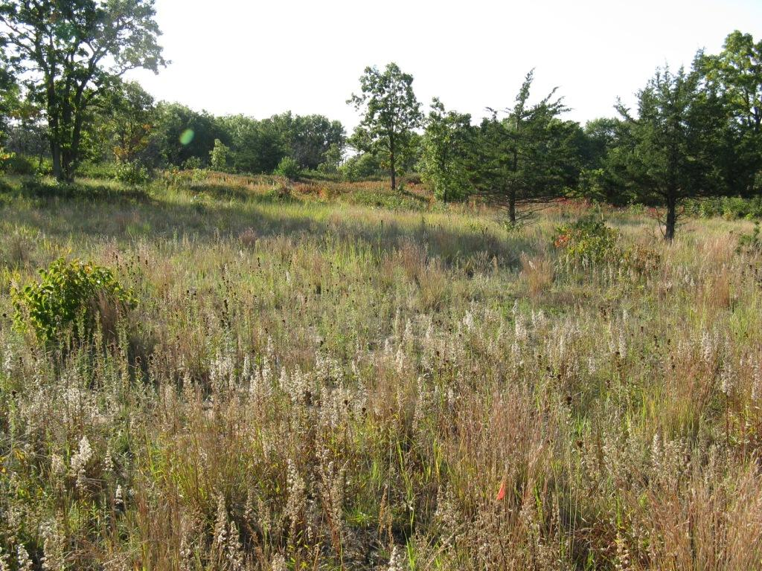

Slide 98
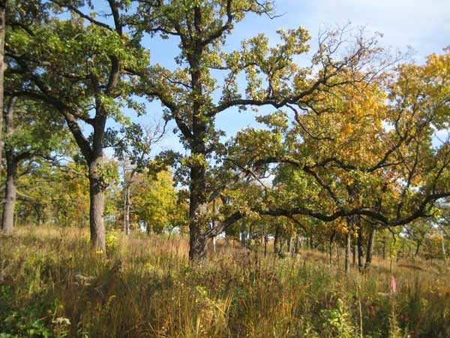

Slide 99
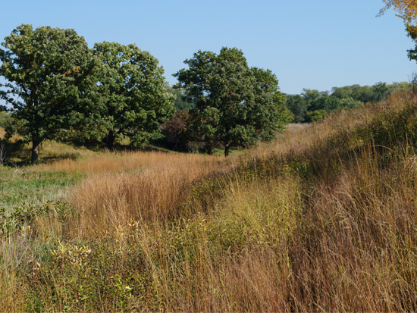

Slide 100
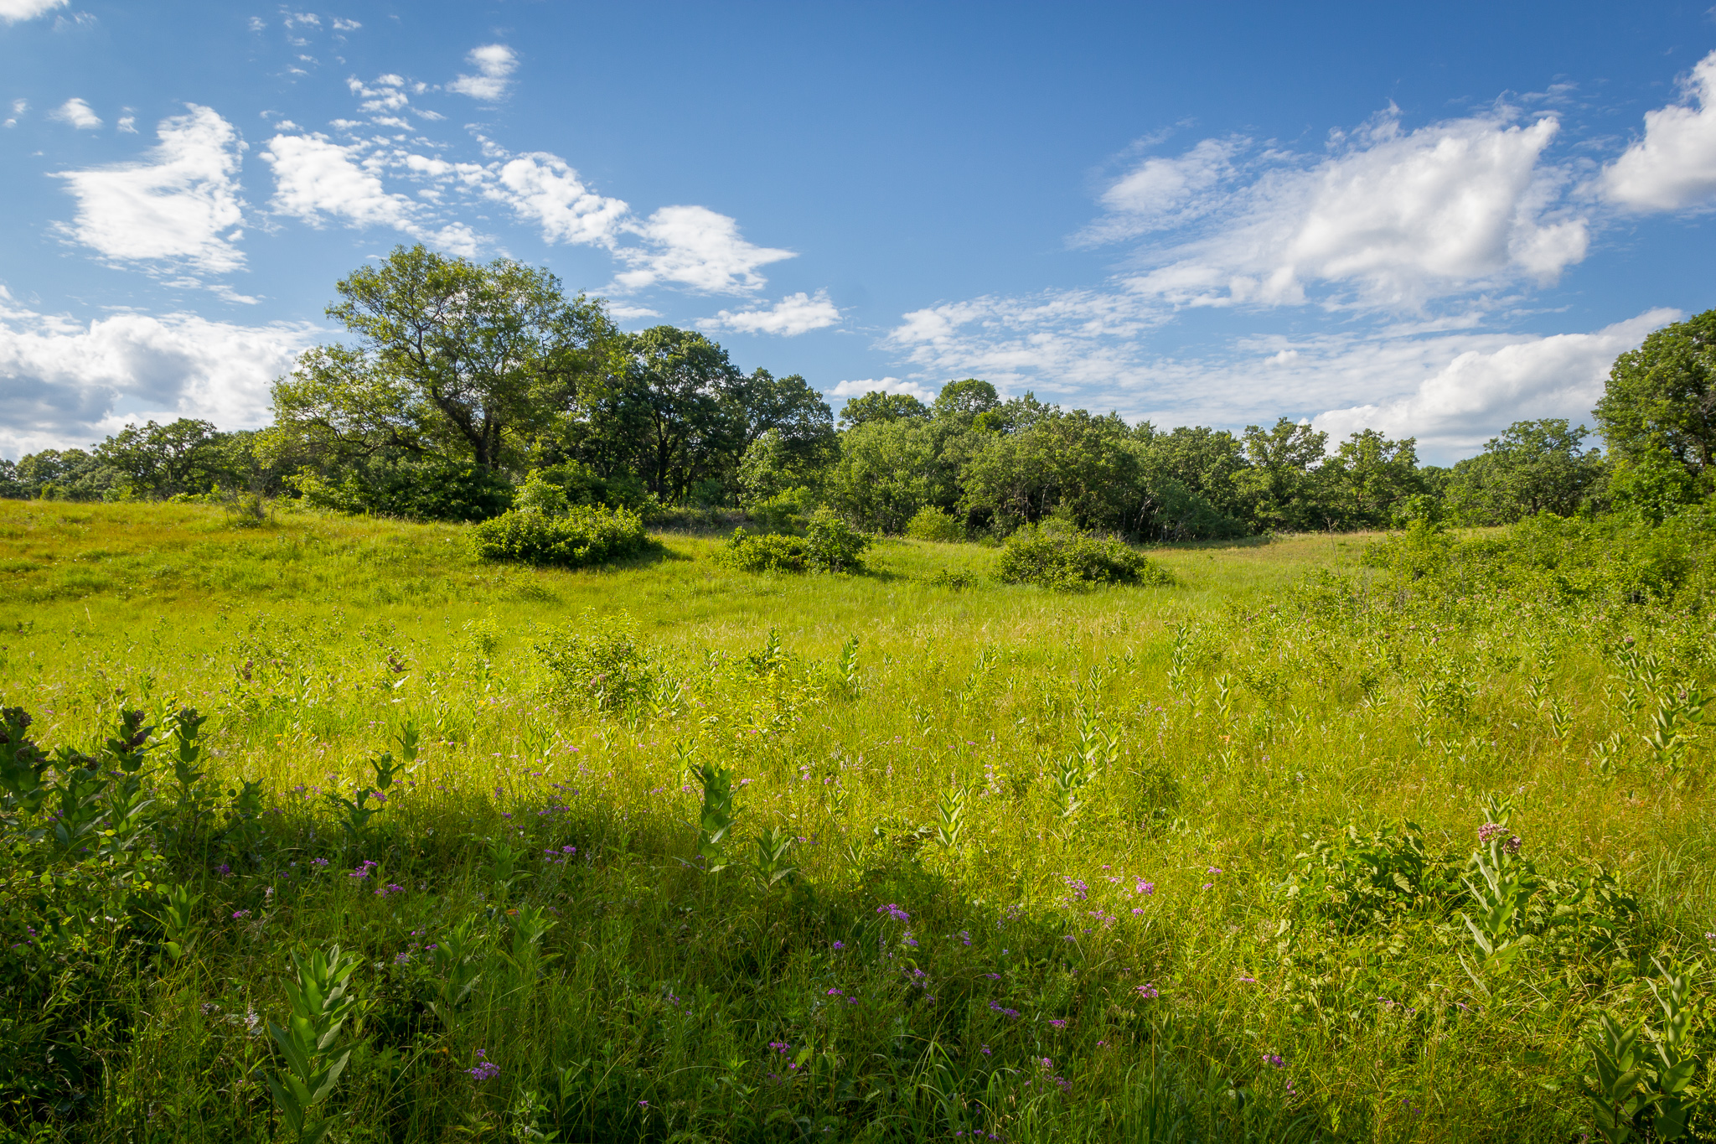

Slide 101
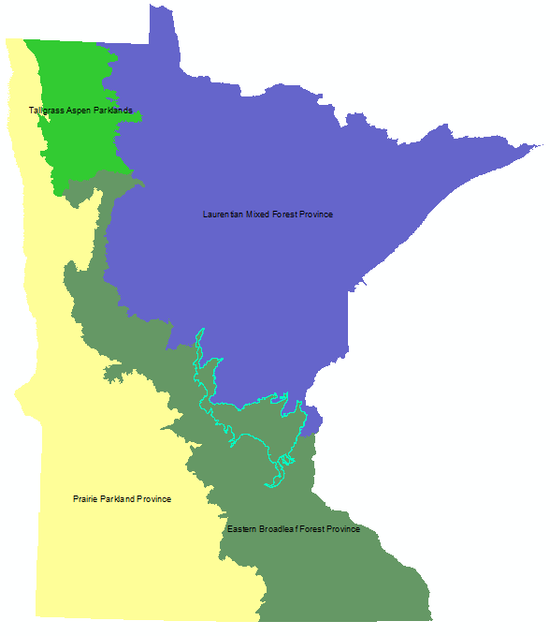
Anoka sand plain

Slide 102
Anoka sand plain

Slide 103
